Slide 1
Flags of the Confederacy
The Confederate States of America adopted three different national flag patterns between 1861 and 1865.

Slide 2
The Provisional Confederate Congress adopted the First National pattern, also referred to as the “Stars and Bars,” on March 4, 1861.
This pattern flag flew over the Capitol at Montgomery, Alabama, where the Provisional Congress met prior to the bombardment of Fort Sumter in April 1861.

Slide 3
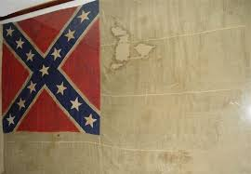
The Second National pattern, also referred to as the “Stainless Banner,” was adopted May 1, 1863 and incorporated the Army of Northern Virginia’s battle flag design.
The first official use of the Second National pattern flag was on Stonewall Jackson's casket when his body lay in state in Richmond, May 10, 1863.

Slide 4
The Third National pattern, adopted March 4, 1865, shortened the white field and added a vertical red bar to the end of the Second National pattern flag.
Very few, if any, of the Third National pattern flags saw service during the war, since General Lee's Army of Northern Virginia surrendered just a few weeks later at Appomattox.

Slide 5
Battle Flags of the Confederacy

Slide 6
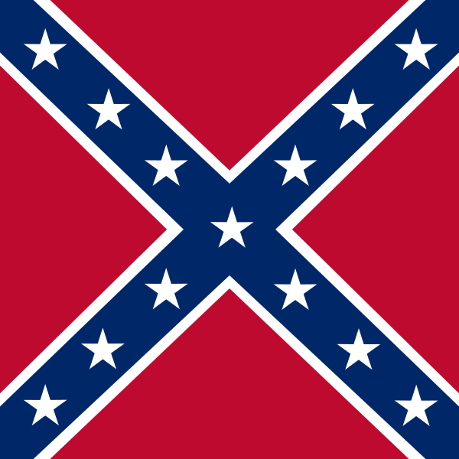
The Army of Northern Virginia battle flag was square, It was used in battle beginning in December 1861 until the fall of the Confederacy.
The flag's stars represented the number of states in the Confederacy, reaching thirteen when the secessionist factions of Kentucky and Missouri joined in late 1861.

Slide 7
The Civil War

Slide 8
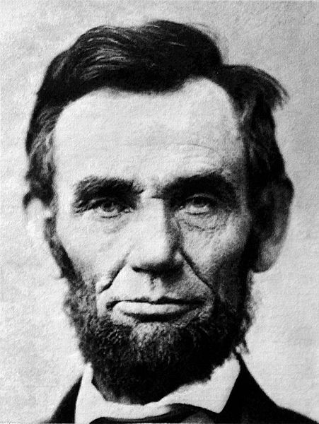
Lincoln Elected as President
Lincoln is elected President in 1860.

Slide 9
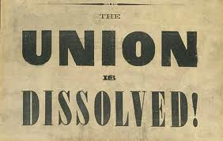
The South Secedes
December 20, 1860 South Carolina (and 6 other states) seceded from the Union

Slide 10
In February 1861 the seceded states met in Montgomery, Alabama and formed the Confederacy or Confederate States of America (CSA)
they wrote their own Constitution like that of the US but protected and recognized slavery in the new territories
each state was sovereign and independent which hampered their unification
Jefferson Davis was elected President of the Confederate States of America

Slide 11
The Confederacy begins to take over all federal facilities in the seceded states including forts, lighthouses, mints, post offices, ships and arsenals.
All of these locations had been paid for with Congressional appropriations (money).
The people who maintained them were federal employees who were forced either to resign their position and move north, or become employees of the Confederate government.

Slide 12
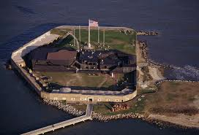
Fort Sumter April 1861
Located in South Carolina on an island in Charleston harbor it was one of two Southern forts that were still Union but the Confederacy was demanding the fort to surrender or face attack

Slide 13
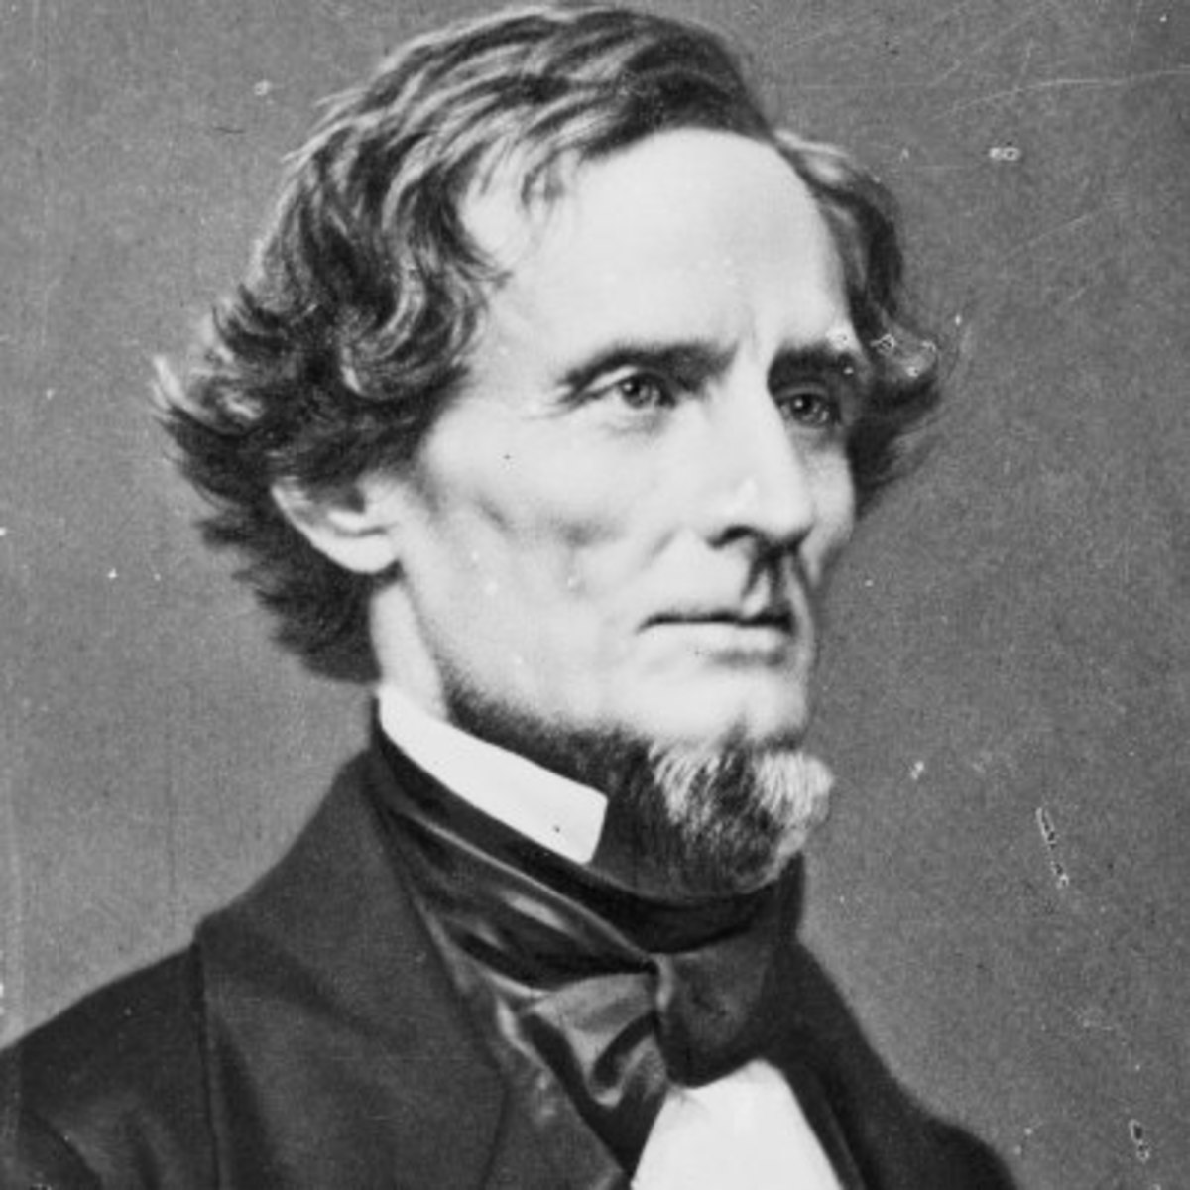
Lincoln/Davis Actions
After Major Anderson messages Lincoln to inform him of Fort Sumter’s limited supply of food and artillery, Lincoln is left with a dilemma.
After Lincoln refuses to evacuate Fort Sumter and chooses to send “food for hungry men”, Jefferson Davis is left with a dilemma.

Slide 14
Lincoln’s Decision
He could reinforce the fort by force, but then he would start armed conflict and border states that had not seceded might then secede
He could order an evacuation, but it would look like he thought the Confederacy was a legitimate nation
He decided to send in food for his soldiers and basically do nothing

Slide 15
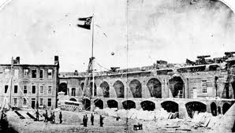
Jefferson Davis’ decision
He could do nothing which would damage the image of the Confederacy as an independent country or he could declare war;
He chose war

Slide 16
Shelling of Fort Sumter
At 4:30 AM on April 12, 1861 Confederate forces begin to fire on the fort
http://www.youtube.com/watch?v=O9p7V7GrHjE
36 hours later the Union Troops surrender
The fall of Fort Sumter united the North and increased enlistment

Slide 17
Lincoln called for 75,000 volunteers which causes
Virginia to secede and join the Confederacy (along with Arkansas, NC and Tennessee) which was a big loss to the North as it was very populated and had good ironworks and navy yard
https://en.wikipedia.org/wiki/Tredegar_Iron_Works

Slide 18
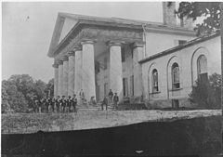
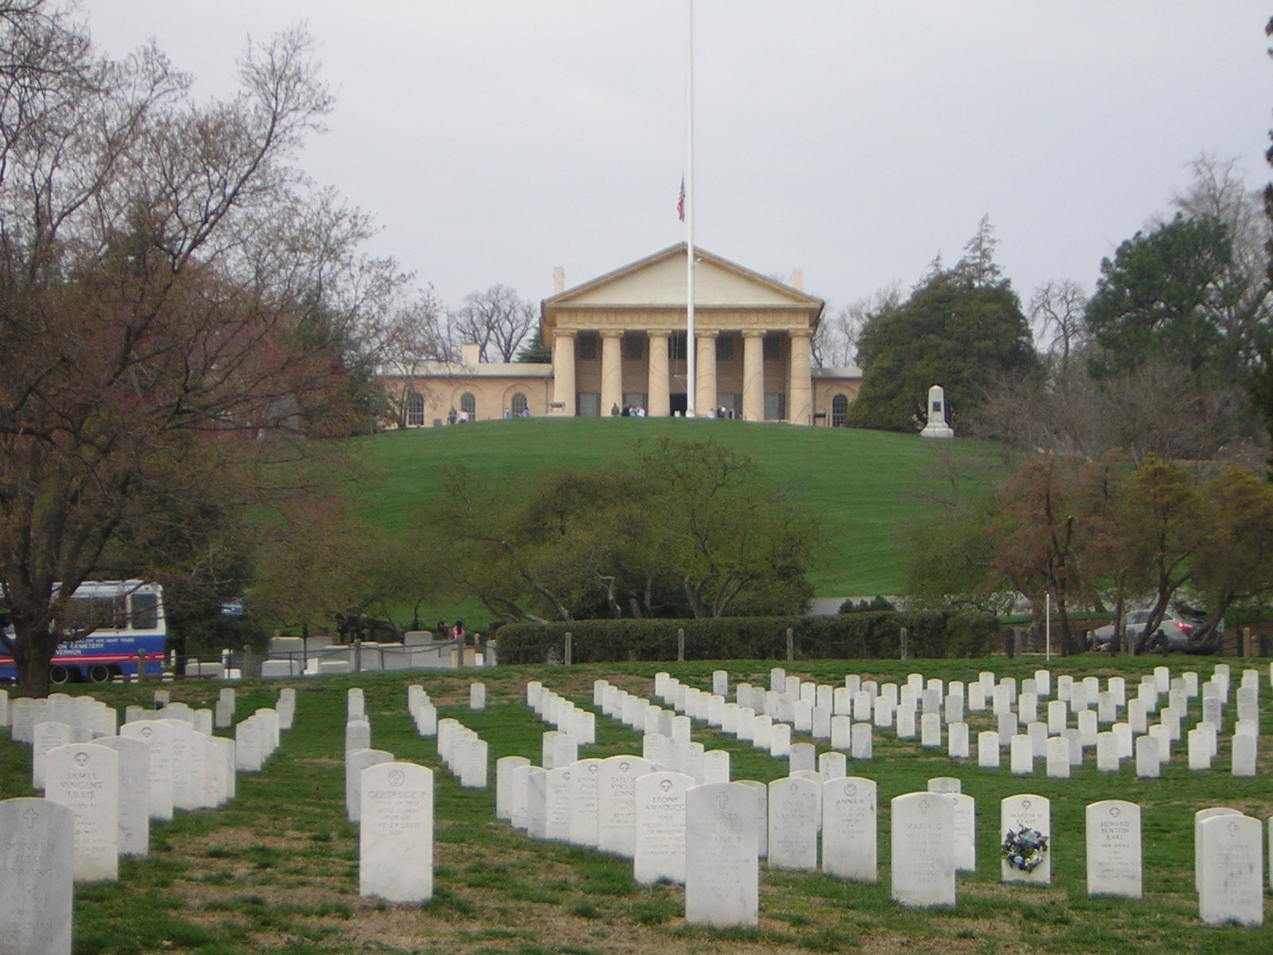
Lee’s Mansion
http://www.arlingtoncemetery.net/arlhouse.htm

Slide 19
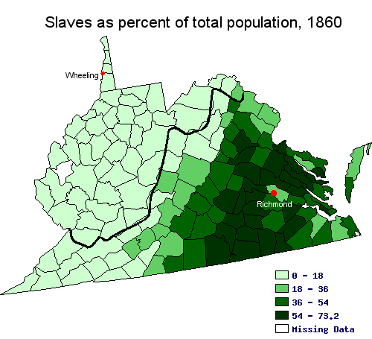
the western part of Virginia was anti-slavery so it would form its own state (West Virginia) and be admitted to the Union

Slide 20
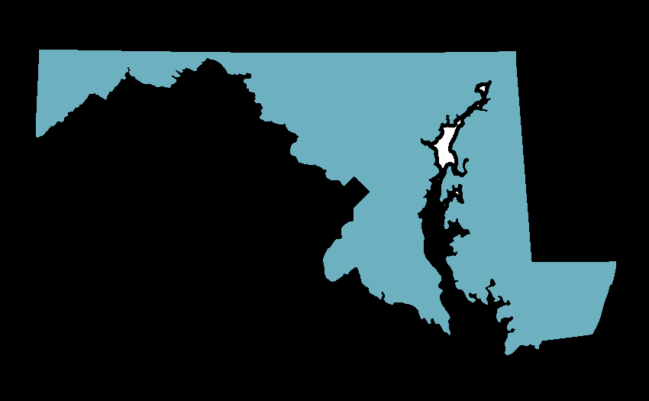
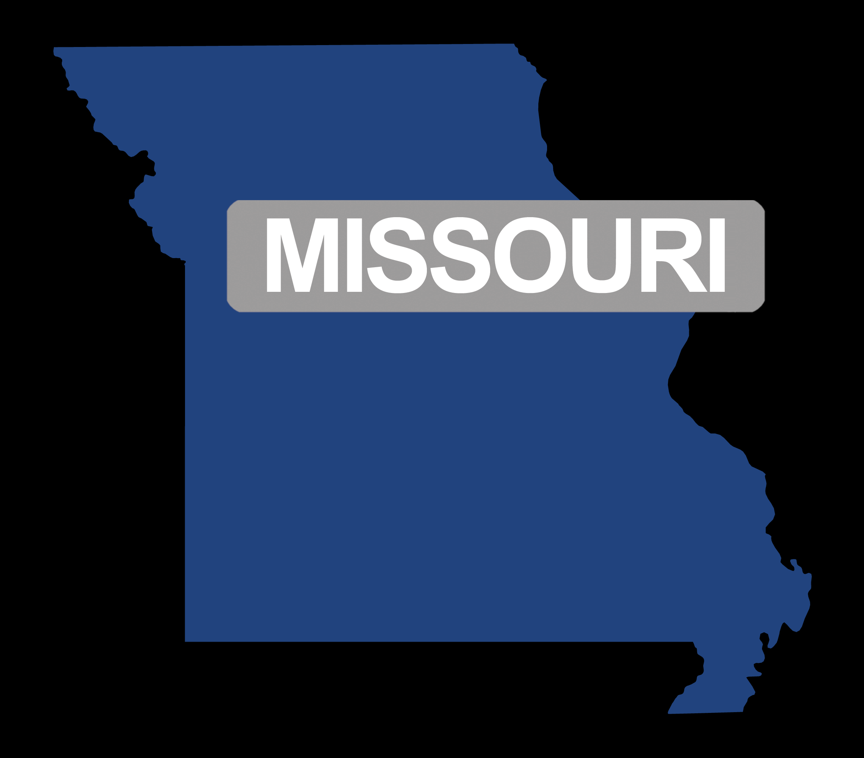
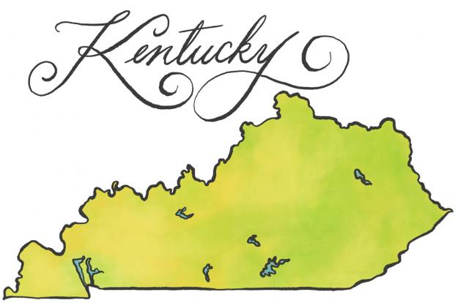
Slave States but Loyal to Union
Four slave states Maryland, Delaware, Kentucky and Missouri decide to stay in the Union

Slide 21
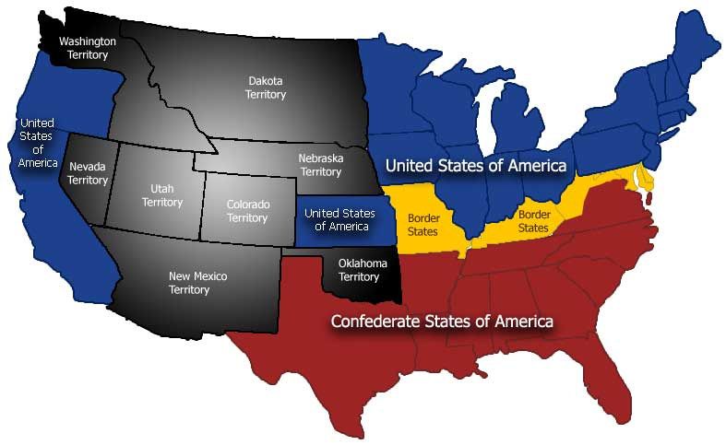
These states are called the “border states”

Slide 22
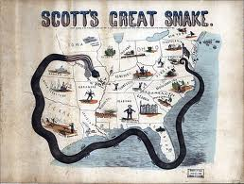
Military strategies: North
called the Anaconda Plan
(1) blockade Southern ports to prevent cotton going out and
imports of manufactured goods coming in
(2) Gain control of the Mississippi
to split the Confederacy
(3) capture the Confederate capital
of Richmond, Virginia

Slide 23
Military strategies: South
Defend itself and if the possibility arose invade the North
http://www.youtube.com/watch?v=nANJYQ9pd_Y

Slide 24
Advantages/Disadvantages Chart

Slide 25
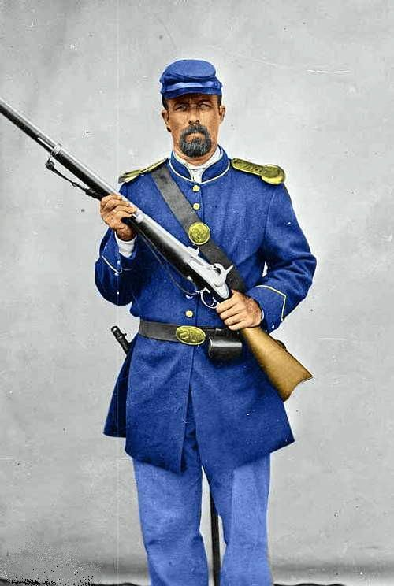
North: Union Facts
President: Abraham Lincoln
Capital – Washington, D.C.
Commanders:
1st – Brigadier General Irvin McDowell
Replaced by Major General George B. McClellan
And finally replaced by: Ulysses S. Grant
Uniform Colors: Blue

Slide 26
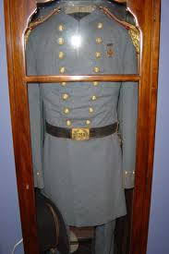
South: Confederacy Facts
President: Jefferson Davis
Capital: Richmond, Virginia
Commanders:
Robert E. Lee and
Braxton Bragg
Uniform Colors: Gray

Slide 27
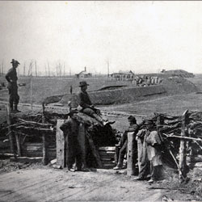
July 1861 - Battle of Bull Run/1st Manassas
The Union attempts to take the Confederate capital of Richmond
The armies meet 25 miles from Washington.

Slide 28
Battle of Bull Run – July 16, 1861
Mark and label - Washington, Richmond and Bull Run - on your maps

Slide 29
both sides are inexperienced.
President Lincoln was anxious for an early advance.
When Winfield Scott and McDowell urged more preparation, Mr. Lincoln said:
"You are green, it is true; but they are green, also; you are green alike."¹

Slide 30
Union Army General Irvin McDowell commanded the Army of Potomac in the first Battle of Bull Run and was relieved shortly thereafter.

Slide 31
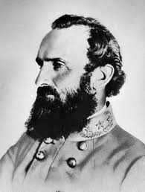
Confederate General Thomas J. Jackson, gained the upper hand and secures victory for the South
Jackson is given his nickname during this battle.
During the battle, Brigadeer-General Barnard E. Bee said to his men, "There is Jackson standing like a stone wall."

Slide 32
Many Southern soldiers return home believing the South has won the war

Slide 33
http://www.civilwar.org/hallowed-ground-magazine/spring-2011/spectators-witness-history-at.html - link to Information about civilians and battle

Slide 34
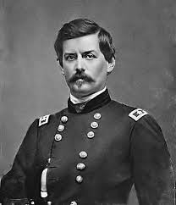
After the defeat at Bull Run Lincoln increased his enlistments and appointed General George McClellan to lead the Union army encamped near Washington, which would be known as the Army of the Potomac
https://en.wikipedia.org/wiki/George_B._McClellan

Slide 35
Fighting in the West – Forts Henry and Donelson
(February 1862) Union General Ulysses S. Grant, captures two Confederate forts of Henry and Donelson on strategic rivers
http://www.civilwar.org/battlefields/fort-donelson.html
U.S. Grant

Slide 36
Forts Henry and Donelson: Feb 6 and 16, 1862

Slide 39
Grant earns his nickname at these battles…
Unconditional Surrender Grant
An unconditional surrender is a surrender in which no guarantees are given to the surrendering party.

Slide 40
Shiloh
Confederate forces surprised Grant (Union)at Shiloh, a small Tennessee church, but reinforcements allowed the Union to counterattack and win
Shiloh means “place of peace”

Slide 41
Shiloh: April 6-7, 1862

Slide 43
http://www.history.com/topics/american-civil-war/american-civil-war-history/videos/battle-of-shiloh?m=528e394da93ae&s=undefined&f=1&free=false

Slide 44
New Orleans: April 24-29, 1862

Slide 45
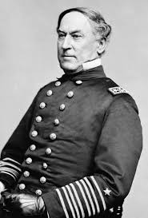
New Orleans: April 24-29, 1862
In the middle of the night of April 24, Admiral David Farragut led a fleet of 24 gunboats, 19 mortar boats, and 15,000 soldiers in a daring run up the Mississippi toward New Orleans.

Slide 46
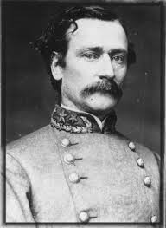
Only 3,000 militia, two uncompleted ironclads, and a few steamboats were available to defend New Orleans.
The Union ships plowed right through, sinking eight ships.
At New Orleans, Confederate General
Mansfield Lovell surveyed his tiny force
and realized that resistance was futile.

Slide 47
Lovell pulled his troops out of New Orleans and the Yankees began arriving on April 25.
Crowds cursed the Yankees as all Confederate flags in the city were lowered and stars and stripes were raised in their place.
The Union is now in position to cut the Confederacy in two.

Slide 48
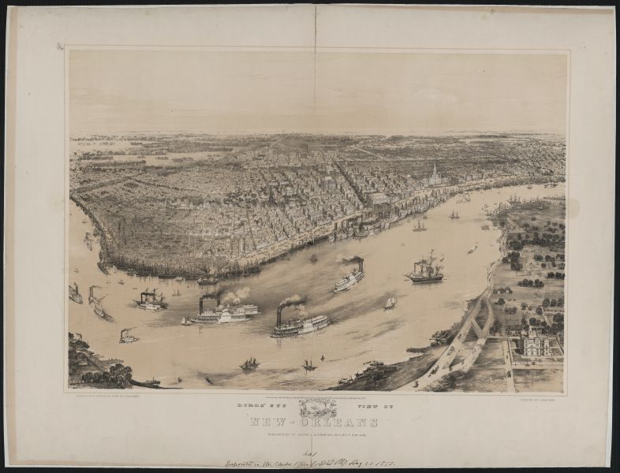
New Orleans: April 24-29, 1862
The Confederacy
lost a major city,
and the Mississippi soon became a
Union highway for
400 miles to
Vicksburg, Mississippi.

Slide 49
Is the Union’s war strategy working?
How do you know?

Slide 50
The victories at Forts Henry/Donelson, Shiloh, and New Orleans are a signal to the Union that their Anaconda Plan of using the Mississippi to split the Confederacy might work
The Union campaign along the Mississippi would continue

