Slide 1
Religion & Reform

Slide 2
RECAP: The Great Awakening (1730s)
- ministers concerned that people were becoming too concerned with wealth and worldly matters began to preach that being truly religious meant trusting the heart (listening to the church) rather than the head (Enlightenment ideas)

Slide 3
The Second Great Awakening Late 1700’s to early 1800’s
In the 2nd Great Awakening the focus on religion shifts to individuals.
The idea is that people determined their own salvation (repent to be forgiven of sin).
There was extreme faith in what an individual can do

Slide 4
The Second Great Awakening
(late 1700’s to early 1800’s)
The Second Great Awakening leads to Social Reforms & Redefining the Ideal of Equality
Abolitionism
Temperance
Education
Asylum & Penal Reform
Women’s Rights

Slide 5
Revivalism
Revival – an awakening
Focused on emotional preaching and instant conversion
Preachers were easily understood by the uneducated

Slide 6
The Problem: Low Church Attendance
By 1800, church membership in was low & falling; Just 1 out of 15 people in America was a member of a church
Poverty, crime, & immorality seemed to be increasing at an alarming rate

Slide 7
The Solution: Second Great Awakening (Revivalism Section)
In the early 1800s, evangelists like Charles Finney led religious revivals called the Second Great Awakening:
Highly emotional “camp meetings” with thousands in attendance
Preachers talked about forgiveness of sin & acting morally
By 1850, 1 in 6 Americans was a member of a church

Slide 8
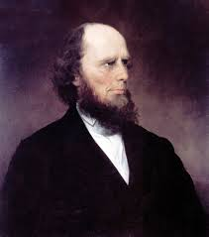
Dominant preacher:
Charles G. Finney
The ranges of tents, the fires, reflecting light…; the candles and lamps illuminating the encampment; hundreds moving to and fro…;the preaching, praying, singing, and shouting,… like the sound of many waters, was enough to swallow up all the powers of contemplation.
**Put this in the revivalism section

Slide 9
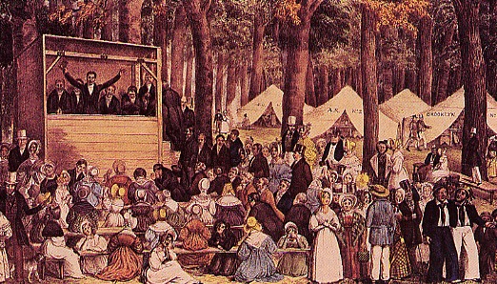
Second Great Awakening Revival Meeting

Slide 10
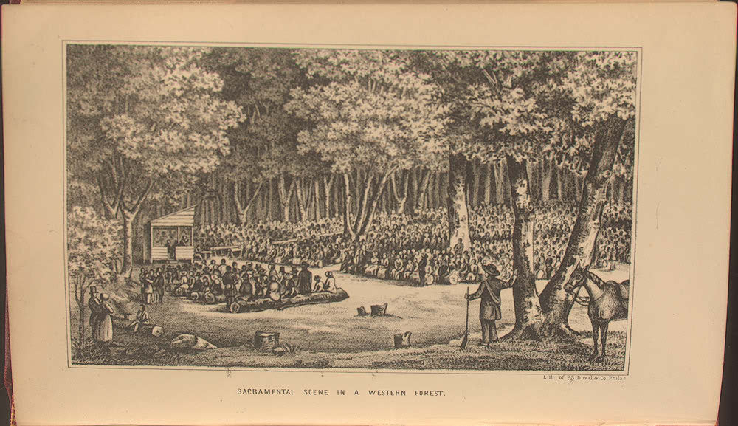

Slide 11
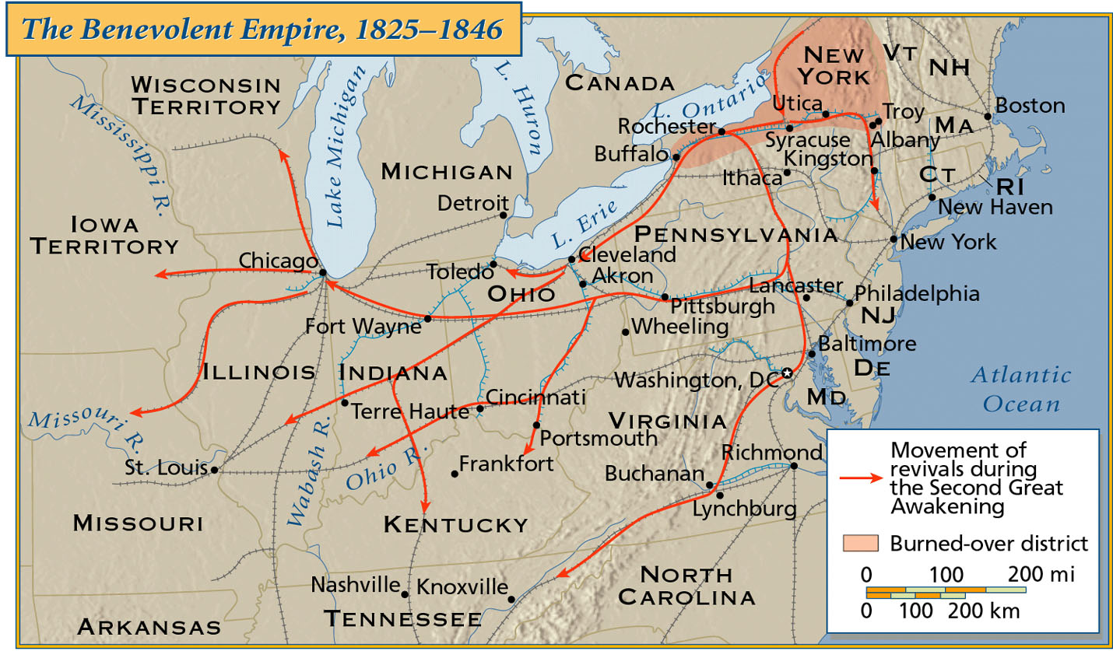
Movement of Revivals

Slide 12
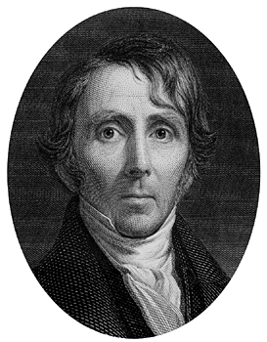
Unitarians
Appealed to reason and conscience NOT emotion
Believed religious conversion was a gradual process not immediate
Most well known leader
Ellery Channing

Slide 13
A.M.E.Church (African Methodist Episcopal Church)
African Americans formed their own churches in the North and supported the anti-slavery cause (abolition)
The black church becomes the #1 institution in the lives of free blacks

Slide 14
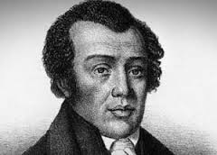
A.M.E Church
Richard Allen, preacher and founder

Slide 15
The Problem : Alcohol Abuse
By 1800, alcohol abuse was seen as a serious problem in America:
Whiskey was cheap to make & buy
By 1820, the typical adult American drank more than 7 gallons of alcohol per year (Today, its 2.6 gallons)
Alcohol was linked to crime, debt, domestic abuse, & unproductive employees
Notes:
Reformers identified liquor as the cause of a wide range of social, family, and personal problems. Many middle-class women blamed alcohol for the abuse of wives and children and the squandering of family resources. Many businesspeople identified drinking with crime, poverty, and inefficient and unproductive employees.

Slide 16
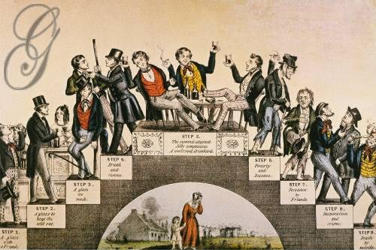

Slide 17
The Solution: Temperance
One of the first reforms movements was temperance—to get people to stop drinking:
Women played an important role in the temperance movement
Reformers convinced people to make a “pledge” to not drink
From 1820 to 1830, drinking fell from 7 gallons per person per year to 3 gallons on average

Slide 18
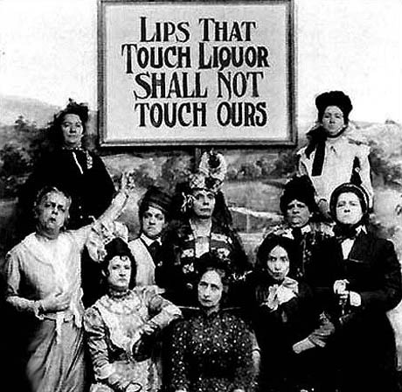

Slide 19
The Problem: Lack of Education
By 1800, the U.S. did not have a true education system for children:
Massachusetts & Vermont were the only states with compulsory (mandatory) attendance laws
In most state schools, classrooms were not divided by grade or age
Few children attended school past the age of 10 years old
Notes:
Before the mid-1800s, no uniform educational policy existed in the United States. School conditions varied across regions. Massachusetts and Vermont were the only states before the Civil War to pass a compulsory school attendance law. Classrooms in the early schools were not divided by grade, so younger and older pupils were thrown together. Few children continued in school beyond the age of ten

Slide 20
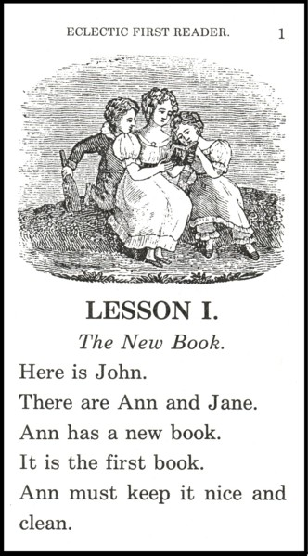
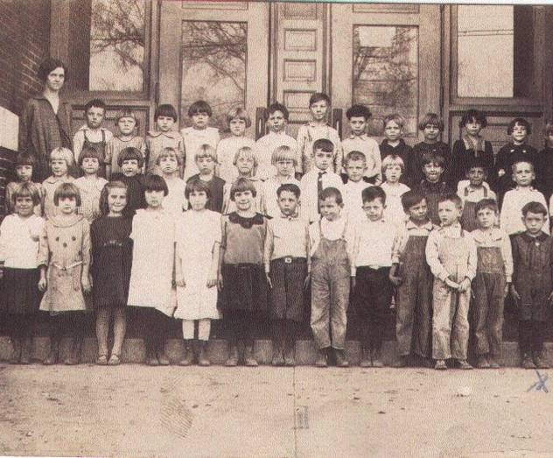

Slide 21
Public Education
MA → always on the forefront of public educational reform * 1st state to establish tax support for local public schools.
Schools began to require
mandatory attendance,
a standard curriculum,
tax support for public schools, and
teacher training.

Slide 22
The Solution: Education Reform
In the 1830s, education reformers demanded that states create public schools for children using tax money
Horace Mann helped create teacher-training & curriculum programs
By 1850, every state had publically-funded schools (but schools in the South & far West were not very good)
By 1860 every state offered free public education to whites. * US had one of the highest literacy rates.

Slide 23
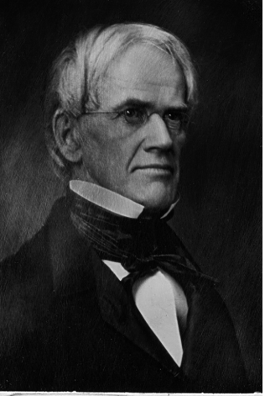
Horace Mann (1796-1859)
“Father of
American Education”
discouraged corporal punishment
established state teacher- training programs
R3-6

Slide 24
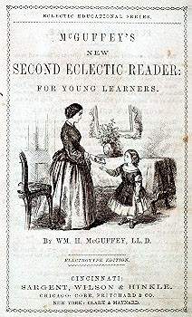
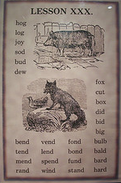
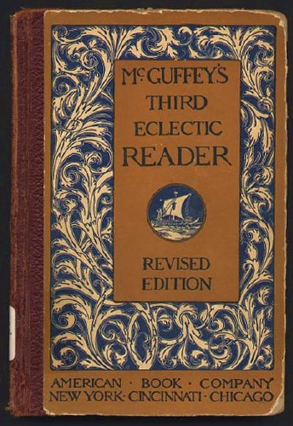
The McGuffey Eclectic Readers
Used religious parables to teach “American values.”
Teach middle class morality and respect for order.
Middle Class Morality
R3-8

Slide 25
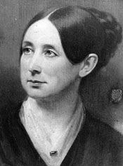
Prison and Asylum Reform
Dorothea Dix
(1802-1887)
1821 → first penitentiary founded in Auburn, NY
R1-5/7

Slide 26
The Problem: Prisoners and Mentally Ill were treated poorly
Prisons: Most prisons were filled to overflowing
Mentally Ill:
Most people who were judged "insane" were locked away in dirty, crowded prison cells. If they misbehaved, they were whipped.

Slide 27
The Solution: Prison and Mental Health Reform
Dorothea Dix and other reformers believed that the mentally ill needed treatment and care, not punishment.
Due to their efforts, many states created special mental hospitals for the mentally ill.

Slide 28
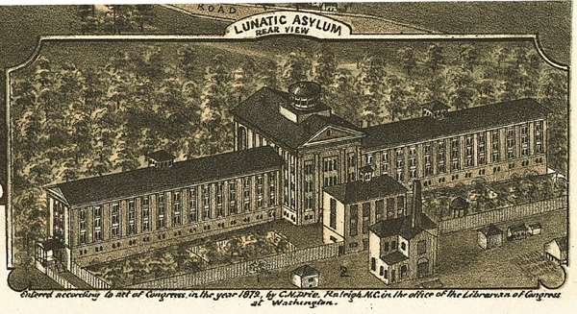
Dorothea Dix Asylum - 1849

Slide 29
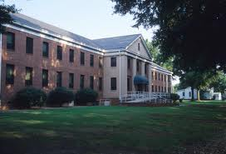
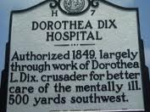
Dix raised awareness of cruel treatment of the mentally ill
She helped establish 9 hospitals in the south
Including one here in Raleigh opened in 1856; closed in 2012

Slide 30
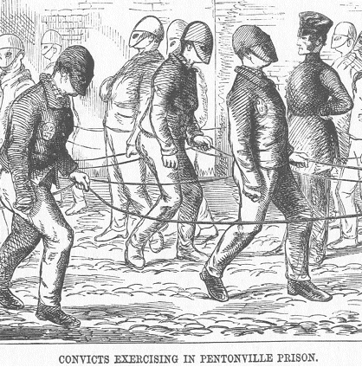

Slide 31
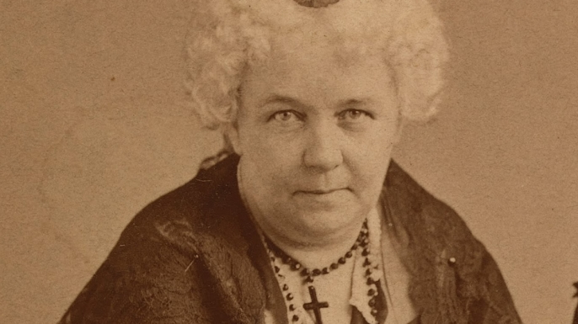
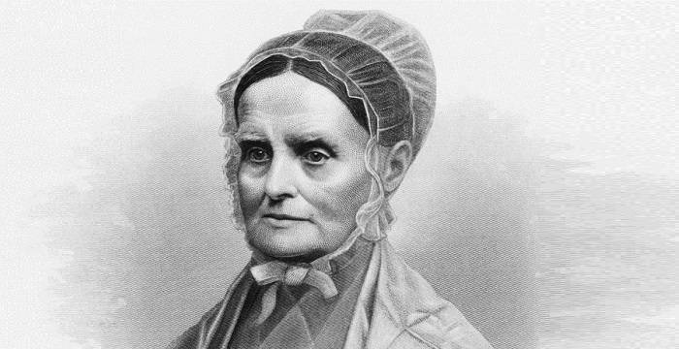
Women’s Movement
Led by Elizabeth Cady Stanton and Lucretia Mott
Women wanted to move away from the cult of domesticity
A meeting was held in Seneca Falls NY in 1848 (called the Seneca Falls Convention) to discuss women’s access to rights such as voting, education, health care
Notes:
The culture of domesticity (often shortened to cult of domesticity^{[1]}) or cult of true womanhood^{[a]} is a term used by some historians to describe what they consider to have been a prevailing value system among the upper and middle classes during the nineteenth century in the United States^{[2]} and Great Britain. This value system emphasized new ideas of femininity, the woman's role within the home and the dynamics of work and family. "True women", according to this idea, were supposed to possess four cardinal virtues: piety, purity, domesticity, and submissiveness. The idea revolved around the woman being the center of the family; she was considered "The light of the home".

Slide 32
The Problem: Women Have Few Rights
By 1800, women’s rights were limited by the Cult of Domesticity:
Women were expected to oversee the family & home while their husbands worked to provide money
Married women had no property rights & could not file for divorce
Women could not vote, run for political office, or sue in court
Notes:
Women were unable to vote
Single women could own her own property
Married women had no control over her property or her children
Women could not initiate divorce
Women could not sign a contract or sue in court without her husband’s permission

Slide 33
The Solution: Seneca Falls Convention
Women’s activism in other reforms led them to demand women’s rights:
In 1848, Elizabeth Cady Stanton helped organize the Seneca Falls Convention & proclaimed that “all men & women are created equal” (in the Declaration of Sentiments)
They demanded the right to vote
Women did not gain this right until the 19th Amendment in 1920

Slide 34
“Men and women were CREATED EQUAL; they are both moral and accountable beings, and whatever is right for a man to do, is right for a woman to do. What then can woman do for the slave, when she herself is under the feet of man and shamed into silence.” —Sarah & Angelina Grimké, 1840

Slide 35
Abolitionist Movement
A variety of approaches:
Some favor non-violence – William Lloyd Garrison, Frederick Douglass
Others had no problem with violence – Nat Turner, David Walker

Slide 36
The Problem: Slavery
From 1810 to 1830, “King Cotton” led to a huge growth in the slave population.
By the 1830s, Northerners began to view slavery as immoral:
All Northern states abolished slavery
Slave rebellions & escaping to freedom through the Underground Railroad became more common

Slide 37
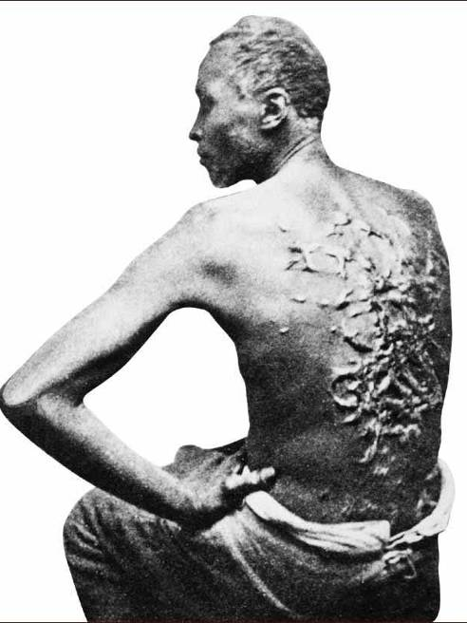
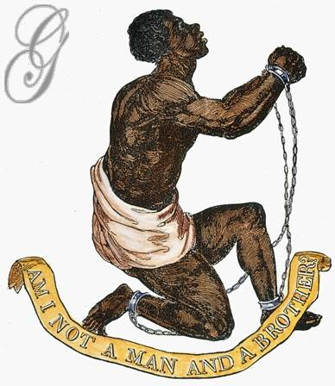

Slide 38
The Solution: Abolition
In the 1830s, abolitionism (desire to emancipate all slaves) grew radical:
William Lloyd Garrison created The Liberator newspaper & demanded the immediate end to slavery without payment to slave masters
Frederick Douglass was a runaway slave who was a popular critic of slavery in his North Star newspaper
Abolition divided the North & South

Slide 39
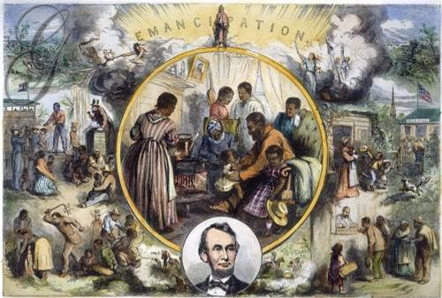
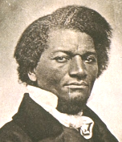

Slide 40
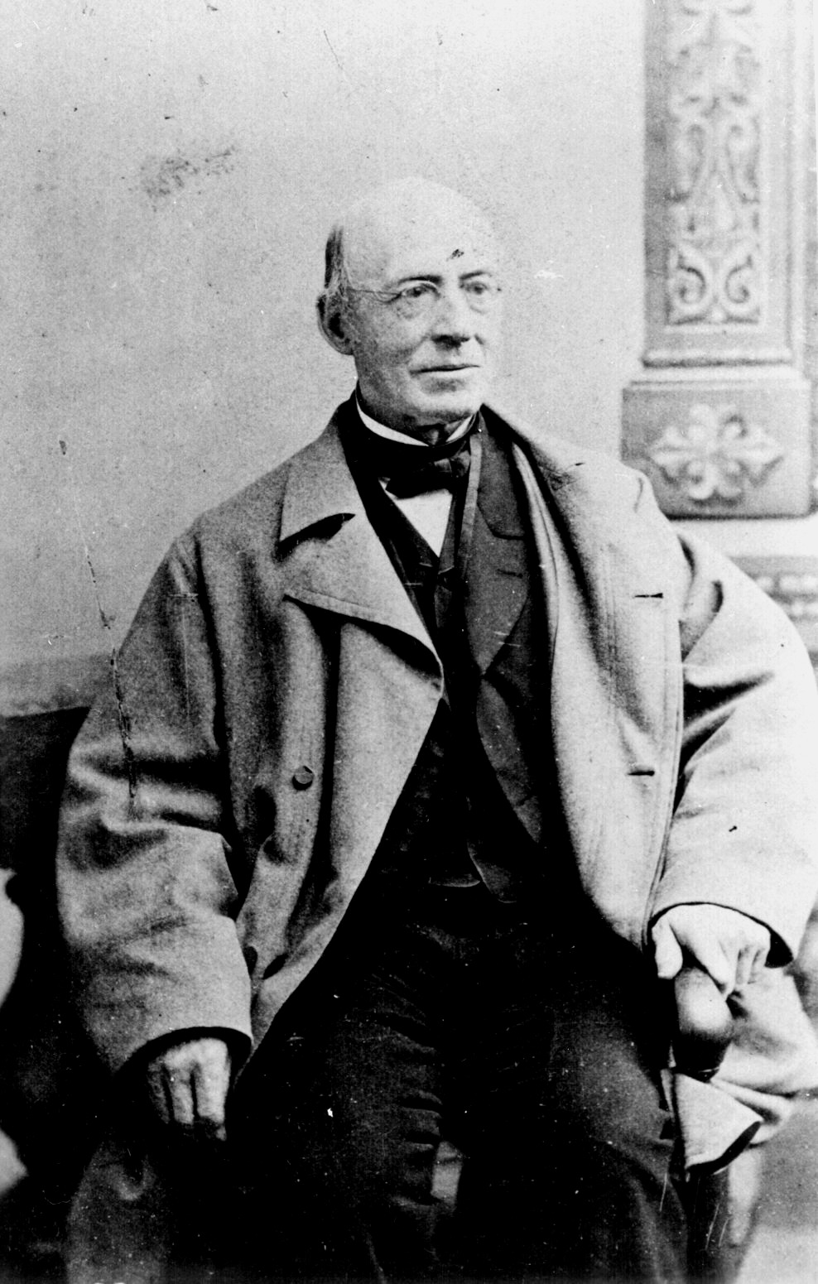
William Lloyd Garrison (1801-1879)
Immediate emancipation with NO compensation.
Slavery was a moral, not an economic issue.
Favored non-violent movement
R2-4

Slide 41
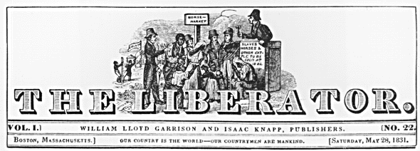
The Liberator
Anti-slavery Newspaper
Written by Garrison
R2-5

Slide 42
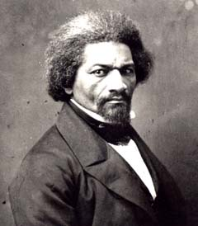
Frederick Douglass (1817-1895)
Douglass escaped to freedom in NY and became a lecturer for the Anti-Slavery Society
He was later sponsored by W.L. Garrison
R2-12

Slide 43
1847 he began publishing “The North Star” – a newspaper he wrote named after the star that guided runaway slaves.
He also favored non-violence

Slide 44
David Walker (1785-1830)
A free black from North Carolina
Encouraged blacks to Fight and take their
freedom by force rather than wait to be set free by whites.

Slide 45
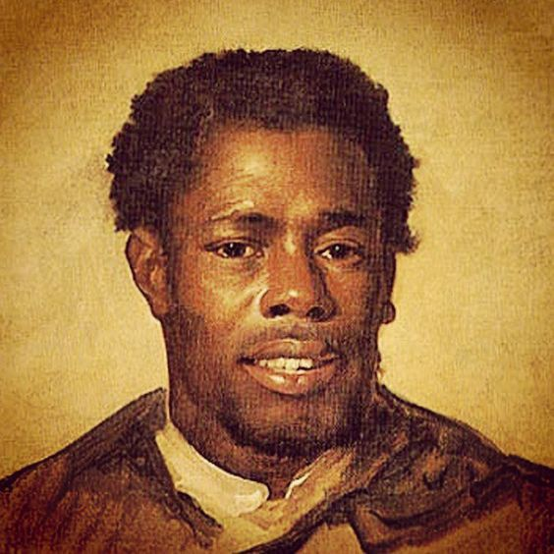
Nat Turner
Led a rebellion of 50 followers in 1831 in Virginia
Killed 70 white people
Turner was captured and hanged
The rebellion made people in the south fight even harder to keep slavery

Slide 46
Slave Code restrictions…
Neither free nor enslaved blacks could preach about God
Took away right to vote
Could not own guns, purchase alcohol, assemble in public, testify in court

Slide 47
Slave Code restrictions…
Could not own private property
Learn to read or write
Arguments to support slavery…
Bible
Slaves benefitted from slavery
“happy slave”

Slide 48
Transcendentalism
A literary and philosophical movement
Value nature and what it can teach you
Stressed having a Personal relationship with God, individuality and personal improvement

Slide 49
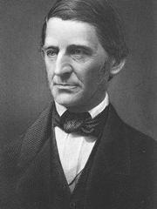
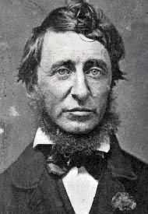
Transcendentalist Intellectuals/Writers Concord, MA
Ralph Waldo
Emerson
Henry David
Thoreau
Nature (1832)
Resistance to Civil Disobedience (1849)
Self-Reliance (1841)
Walden (1854)
“The American Scholar” (1837)
R3-1/3/4/5

Slide 50
Utopian Communities
Groups trying to create a “utopian” (perfect) place
No utopian communities were very successful – members could not agree on operating methods or philosophies

Slide 51
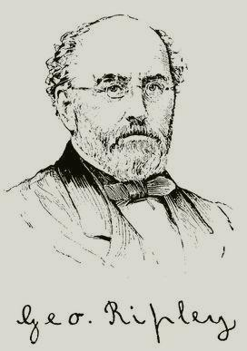
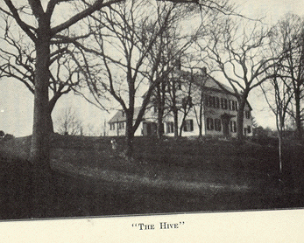
Brook Farm West Roxbury, MA
Founder - George Ripley

Slide 52
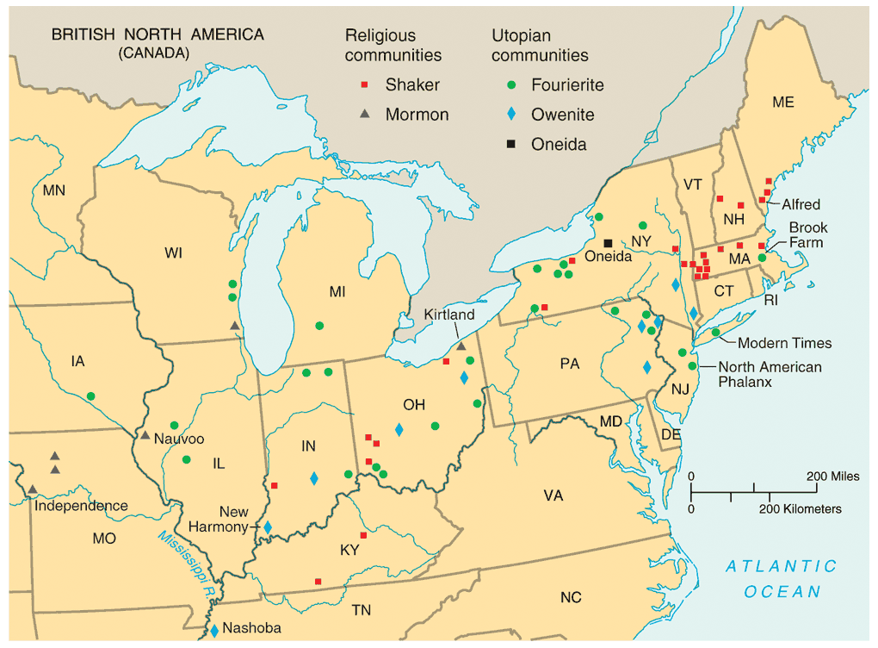
Utopian Communities

