Slide 1
Dred Scott, Lecompton Const., Lincoln Douglas Debates and Freeport Doctrine
AMH1

Slide 2
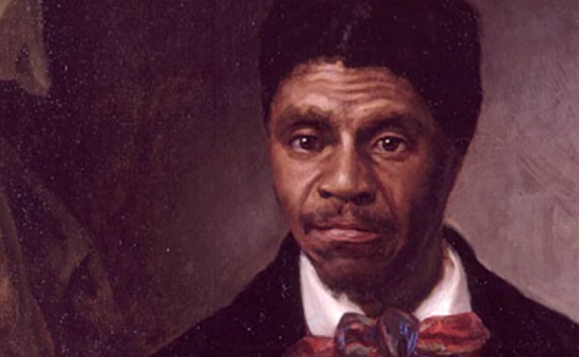
Dred Scott v. Sanford (1856)
Dred Scott v. Sanford Video

Slide 3
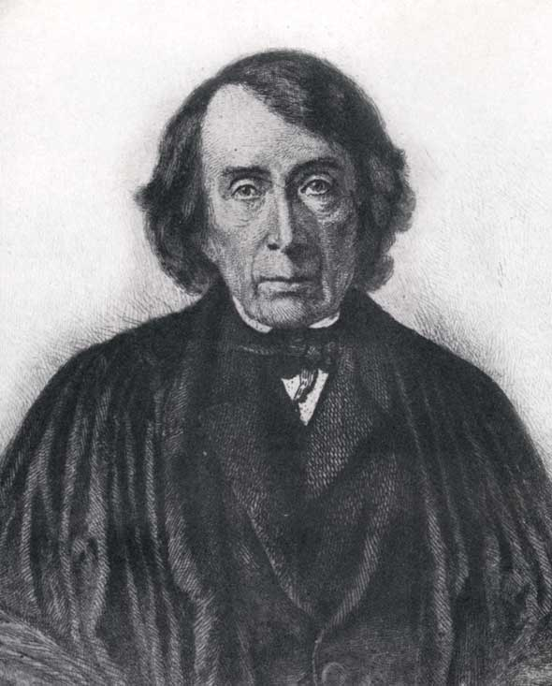
Dred Scott v. Sanford (1856)
Who was involved?
Dred Scott – Slave
John F. Sanford – Final Slave Owner
Roger B. Taney – Chief Justice

Slide 4
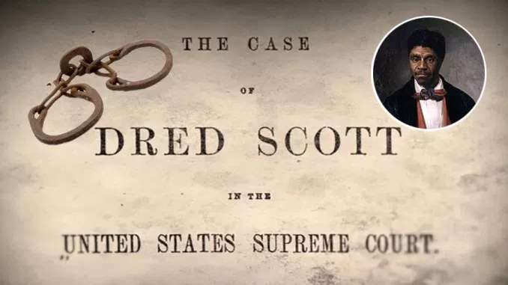
Three Major Questions posed by Dred Scott v. Sanford (1856)
1. Could slaves be considered citizens?
2. Did living in a free state make you free?
3. Was the Missouri Compromise constitutional? Could certain states forbid slavery?

Slide 5
Answers:
1. No, slaves could not be citizens of the United States because they were property.
2. Dred Scott was living in slave state at the time of the lawsuit—thus, he couldn’t make the claim that living in free state garnered him his freedom.
3. Missouri Compromise was unconstitutional—the states cannot forbid slavery. Forbidding slavery would be a violation of the US Constitution because it would deprive slave owners of their right to property.

Slide 6
Impact in the North / South
The North was stunned.
There was widespread fear that slavery would extend throughout the US due to this controversial court decision.
The South celebrated.
Finally, the federal government protected their rights to property.

Slide 7
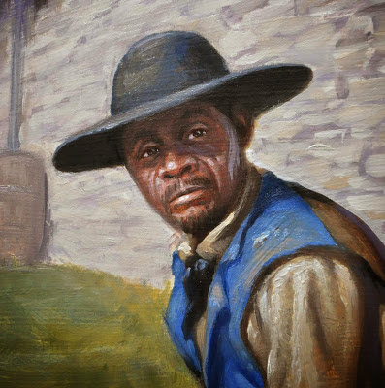
Virginia Slavery v. Minnesota Slavery
In Virginia, slaves worked more on plantations and in agriculture. The work was hard and the days were long.
In Minnesota, slaves were more like manservants—they did the chores that the officers were to good to do for themselves.

Slide 8
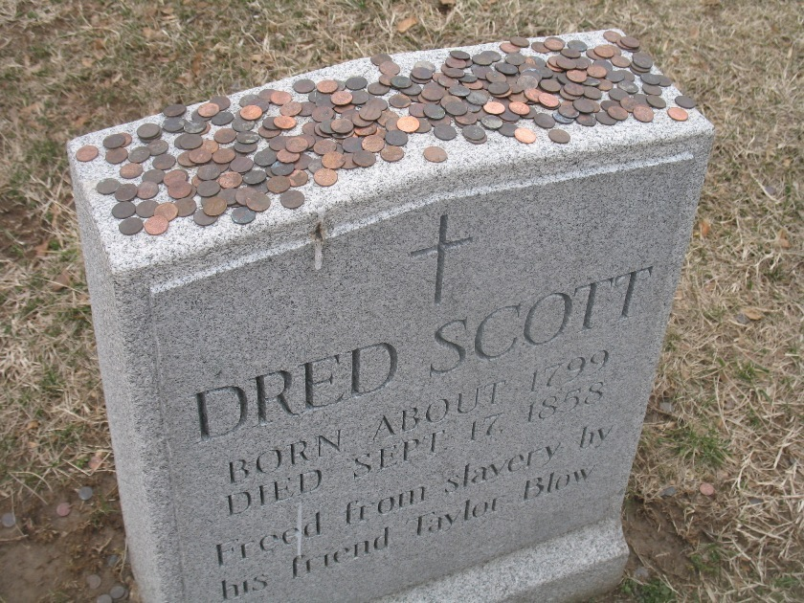
Had legal action for freedom been successful for others?
Yes, many of the 300 slaves who had sued for freedom in St. Louis courts had been successful and had gained their freedom.

Slide 9
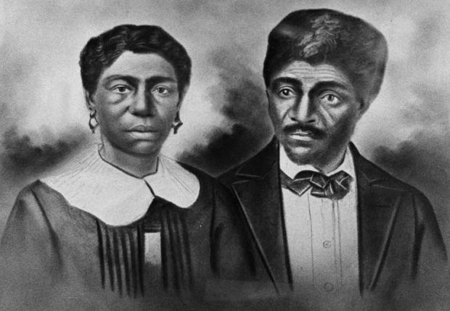
On what did the Scott’s Base their case?
The fact that they had spent multiple years in free territories/ states and felt that this should guarantee their freedom.

Slide 10
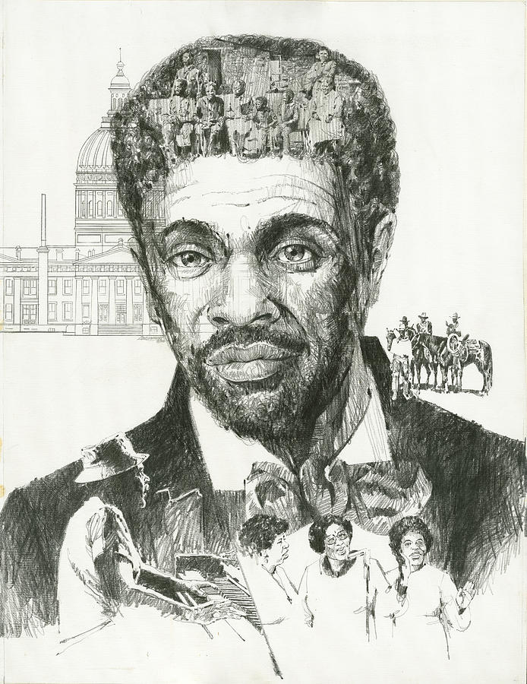
Citizenship for the Scotts?
No! Slaves cannot be citizens of the US because they are property of a US Citizen.

Slide 11
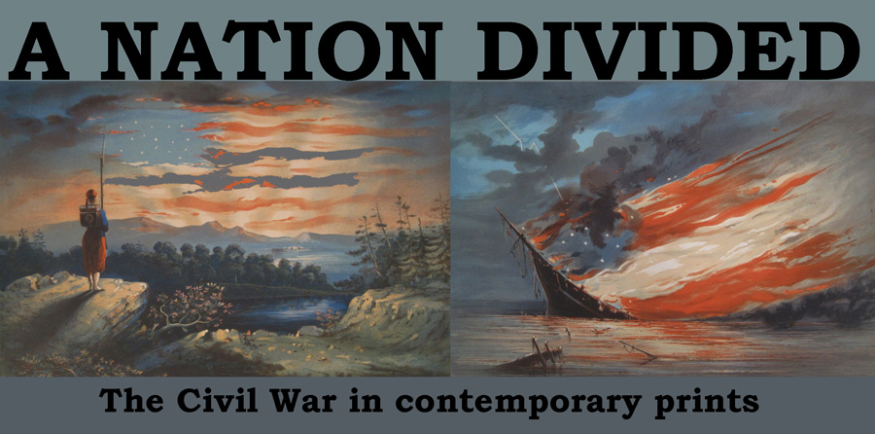
Decision impact??
Sectional passions exploded immediately.
The divide between the North and South widens and we are heading quickly toward war.

Slide 12
Complete Classifying Arguments Section
This is a review of what we JUST covered.
MARK OUT BOTTOM SECTION ON THAT PAGE.
Sorry! It was a miscopy.

Slide 13
Lecompton Constitution
In the Fall of 1857, pro-slavery government in LeCompton, Kansas developed a constitution and applied for statehood.
Due to the fact that anti-slavery Free Soilers outnumbered pro-slavery supporters in Kansas 10-1, the majority of Kansas settlers reject constitution.
The Kansas legislature called for a vote (referendum) on the pro-slavery constitution.

Slide 14
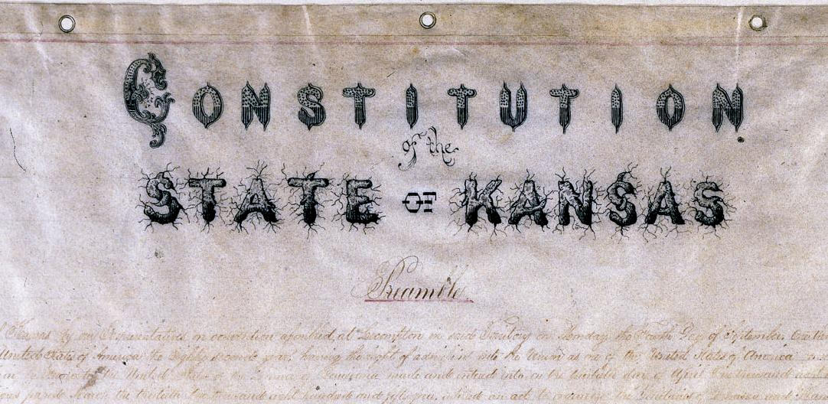
Lecompton Constitution (cont.)
President Buchanan then announces his support for the pro-slavery constitution.
Stephen Douglas (popular sovereignty) is unhappy with Buchanan and wanted the people to decide.
Douglas organized another vote on the proposed constitution.
Voters in Kansas voted against the constitution again.
The North loved Douglas and the South called him a traitor.

Slide 15
Lincoln - Douglas Debates
How many debates? 7
What was the issue? Slavery
When? 1858
Who?
Lincoln – No Name…Only known locally.
Douglas—Two term Senator with successful career.
Lincoln - Douglas Debates

Slide 16
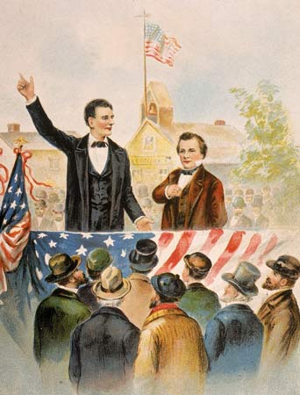
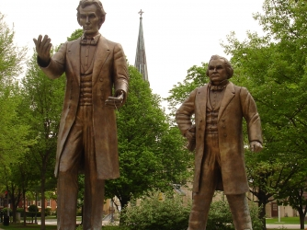
Lincoln - Douglas Debates : Look
Lincoln was abnormally tall and lean
Douglas was short and stout

Slide 17
Lincoln – Douglas Debates : Speaking Styles / Position on Slavery
Douglas – People should have the right to decide for themselves through voting.
Passionate, dramatic and confident speaking style.
Lincoln – People should outlaw slavery immediately. It is immoral and wrong.
Solemnly spoken, plain speech and direct.

Slide 18
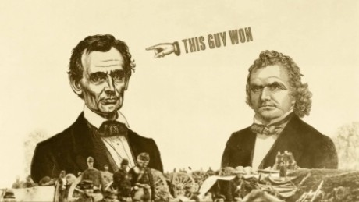
Winner?
Douglas – Won the Senate seat
Lincoln – garnered national attention and would win the nomination for POTUS in 1860

Slide 19
Freeport Doctrine
Lincoln asked Douglas if the settlers of a territory could vote to exclude slavery before the territory became a state.
Everyone knew that the Dred Scott decision said no—that territories could not exclude slavery.
Douglas responded that people could get around the Dred Scott decision by electing officials who won’t enforce slave property laws.

Slide 20
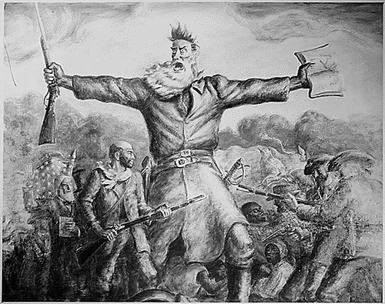
John Brown and the Harper’s Ferry Raid
Harper's Ferry Raid

Slide 21
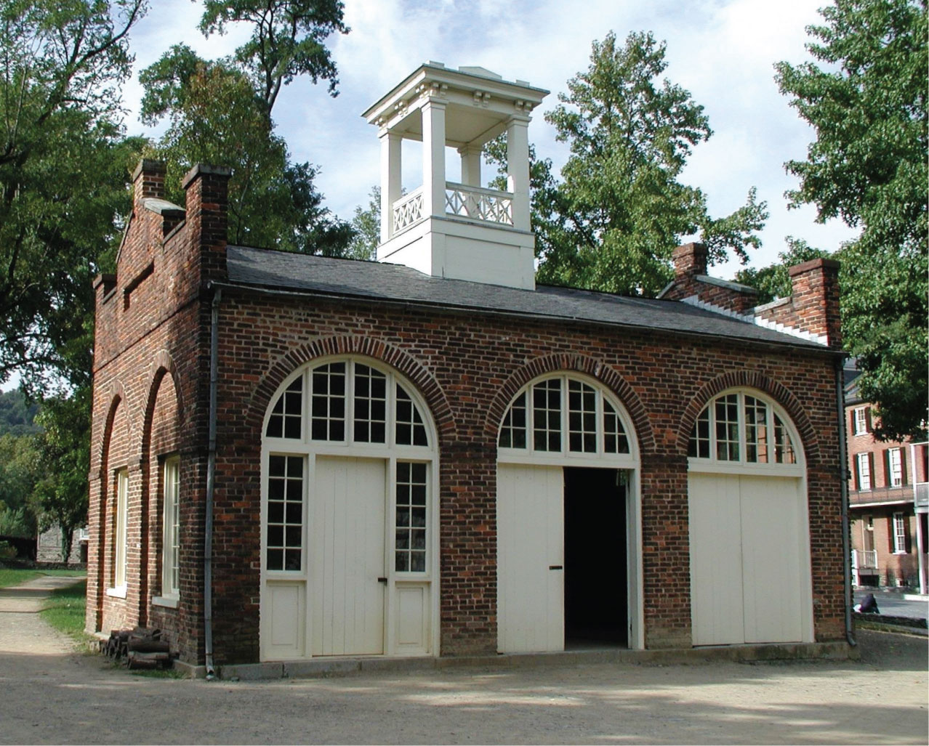
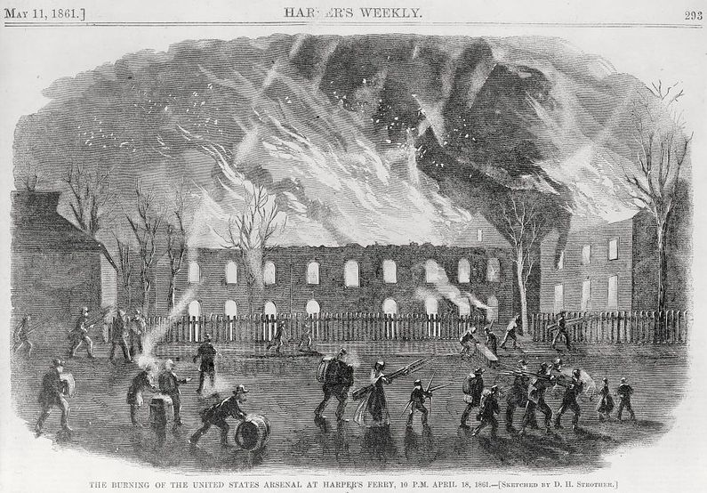
What was the Purpose of the Raid?
To capture the federal arsenal in Harper’s Ferry, VA
Wants to arm southern slaves to lead a slave rebellion.
What is an arsenal??

Slide 22
October 16, 1859
John Brown led 21 men to Harper’s Ferry, VA (now West VA)
He and his supporters held 60 of the town’s most prominent citizens hostage.
Brown hoped that slaves would then join the insurrection.
No slaves came forward, instead local troops killed 8 of Brown’s men.
Finally, General Robert E. Lee and a small detachment of his men stormed the engine house where Brown and his men had barricaded themselves.
Two more men died and the rest were taken and tried for treason. John Brown was hanged for his crimes.

Slide 23
Northerners/ Southerners Reaction
The North, while not agreeing with his tactics, hailed John Brown as a hero and martyr for the cause of abolition
The South was outraged – mobs assaulted any whites who were suspected of holding antislavery views.
Harper’s Ferry terrified slaveholders who were convinced that the North was plotting slave uprisings everywhere.

