Slide 1
Life During Wartime

Slide 2
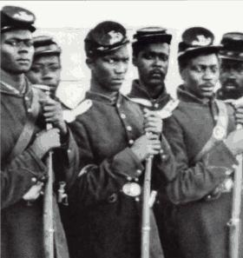
African-Americans in War
Only after the Emancipation Proclamation did the Union accept African-American soldiers;
They suffered discrimination:
their pay was lower
They fought in separate regiments
Not treated as prisoners of war and were
often killed if captured
Fort Pillow massacre: the Confederacy shot more than 200 African-American prisoners and some whites
The South did consider drafting slaves into the army but some felt it would undermine their purpose in fighting

Slide 3
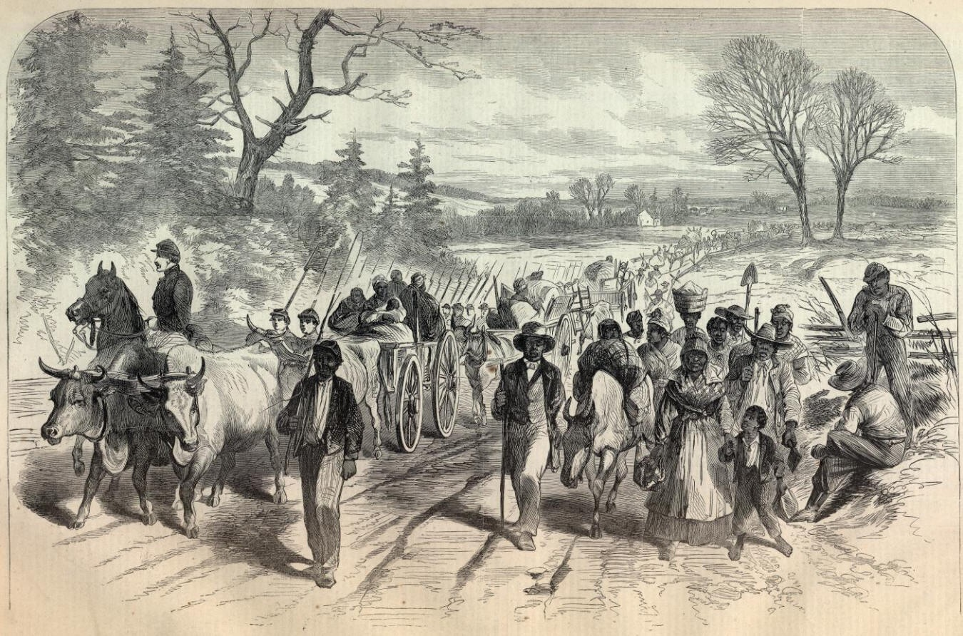
Slaves in the South
Those on plantations would find ways to interfere with daily work like breaking plows, destroying fences, etc.
As the Union advanced many refused to flee with their plantation owners so they could be freed
Slave resistance on
plantations compounded
the stressful atmosphere
and fear of uprising tightened
patrols

Slide 4
Wars Effects
The plantation system declined
The economy of the North would expand during the war while the southern economy would decline

Slide 5
War Effects the Economy of the South
There were food shortages because of…
1. the drain of manpower,
2. the Union was occupying food growing areas, and
3. the loss of slave work in the fields;
meat was scarce; the price of food soared/inflation occurred

Slide 6
“Three rebel officers came up to her (John Fee’s wife) house and asked for food. My wife had some potatoes, meal, coarse flour and milk. She gave to them bread and milk, with baked potatoes. They received this kindly, and were very respectful. Soon after they were gone my wife learned that some rebel soldiers were in her potato patch, grabbing her potatoes.
Taking her son Burritt with her, she went for her potatoes. She came to the fence and said, "Men, I have fed your officers, and now you are taking the last potato I have; this is no credit to you." One young fellow looked up pertly and said, "Madam, credit has gone up long ago." They filled their haversacks and went on.”
From The Autobiography of John Fee

Slide 7
Shortages
The Union blockade created shortages of other goods and smuggling cotton into the North occurred to get gold and food

Slide 8
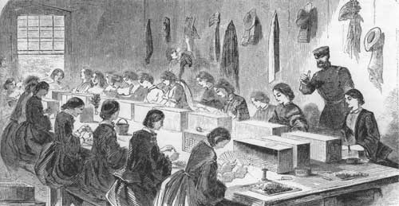
Northern Economy
Northern industries prospered as they supplied items for the war
Downside: Wages could not keep up with the prices and the standard of living declined; factories hired more free blacks, women and children for lower pay
Women entered the
workforce taking over
the jobs of men as they
fought

Slide 9
Economic Impact
Business were making large profits particularly those with government contracts as they were not always honest in their contracts
Congress passed the first income tax which took a specified percentage of an individual’s income

Slide 10
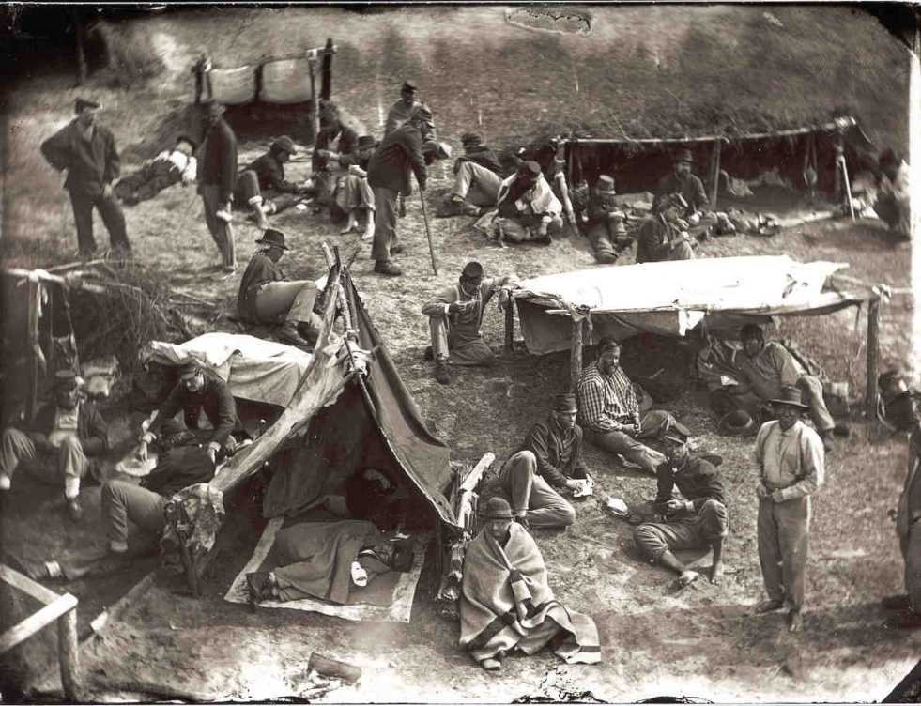
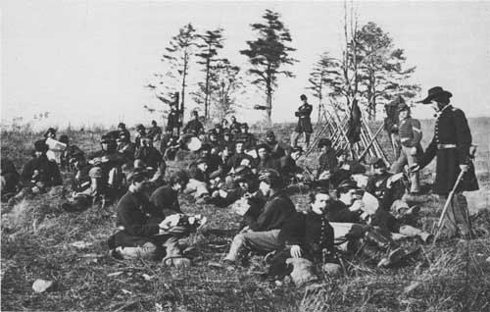
Soldier’s Life
food rations were scarce
hygiene uncommon so there was
body lice, dysentery and diarrhea
there were heavy casualties and medical supplies were limited

Slide 11
Page 354-55
Sect: Soldiers Suffer on Both Sides

Slide 12
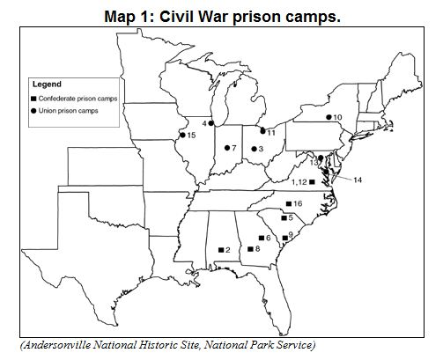
Prisons
war prisons had terrible conditions
Southern prisons were very crowded as the North did not participate in prisoner exchange after the South refused to return African-Americans
war prisons did NOT have
adequate space, food and
sleeping barracks for men
And nothing to protect them
from the harsh winters
where many contracted
pneumonia

Slide 13
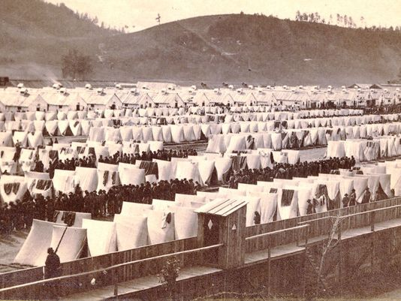
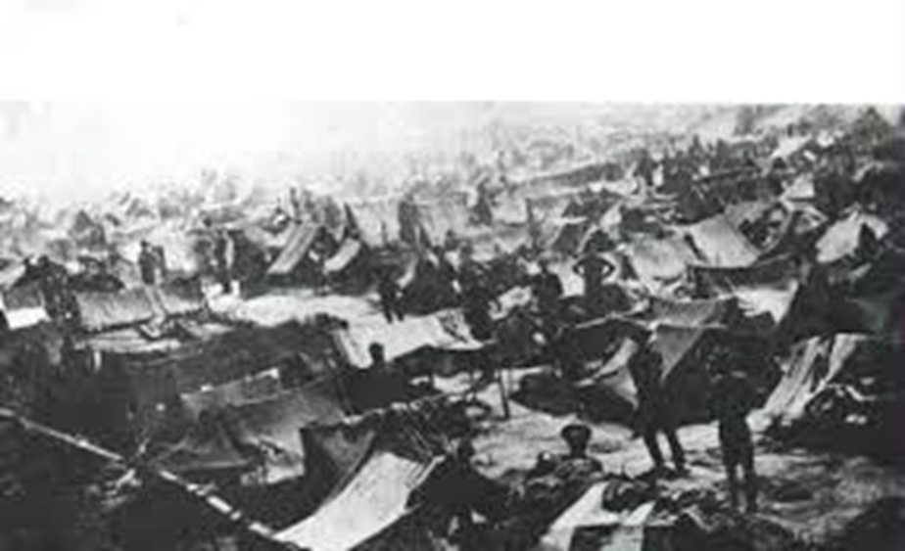

Slide 14
Andersonville Prison,
It was commanded by Captain Henry Wirz, who was tried and executed after the war for war crimes.
It was overcrowded to four times its capacity, with an inadequate water supply, inadequate food rations, and unsanitary conditions.
Of the approximately 45,000 Union prisoners held at Camp Sumter during the war, nearly 13,000 died.
The chief causes of death were scurvy, diarrhea, and dysentery.

Slide 15
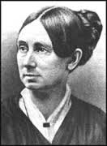
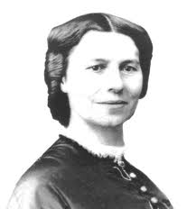
Medical Care
The U.S. government created the
United States Sanitary Commission to…
1. Teach soldiers how to improve
Hygiene
2. train female nurses
Dorothea Dix became the first
Superintendent of Women Nurses
nurse Clara Barton was known as the
“angel of the battlefield”

