Slide 1
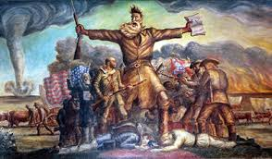

Slide 2
John Brown’s Raid
https://www.youtube.com/watch?v=FIorHCv5QDs

Slide 3
Election of 1860
Evaluate candidates and results

Slide 4
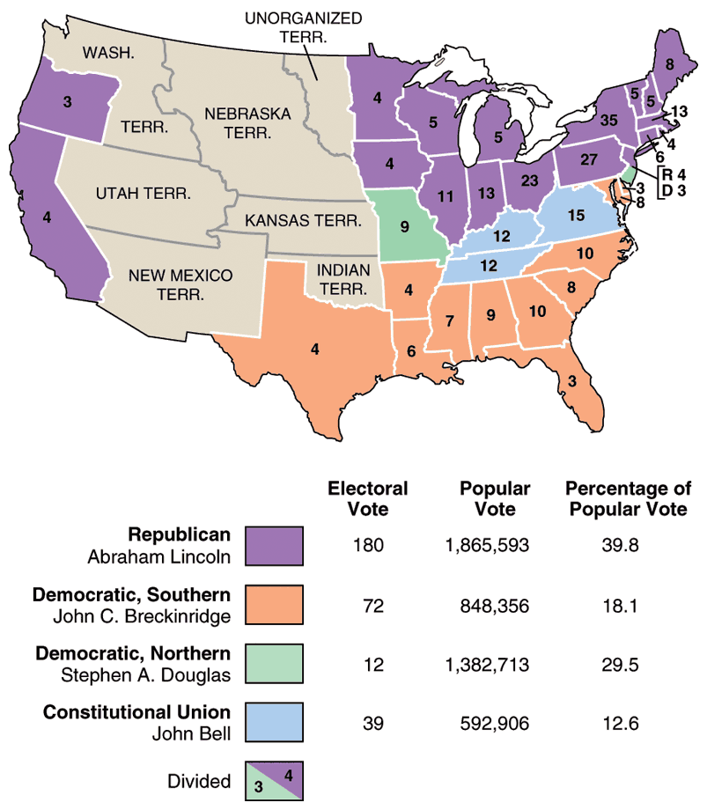
1860
Election
Results

