Slide 1
Great Plains Settlers

Slide 2
Cowboys
What do you know?
#1 True or False?
The career of a cowboy lasted from about 25 years of age to about 40 years of age.

Slide 3
True!
40 was old for a cowboy because of the large amount of riding and work required.
#2 True or False?
The most frequent cause of death for a cowboy was from Native American’s or cattle rustlers.

Slide 4
False!
Pneumonia or riding accidents caused most cowboy deaths
#3 True or False?
Cowboys had to be expert marksmen to protect the herd from cattle rustlers and Native American raiders.

Slide 5
False!!
A cowboy probably did not carry a pistol. If any gun was carried it would be a shotgun. Odds are very good most cowboys never shot anyone.
Does this surprise you? It is probably due to old western movies like this one…

Slide 6
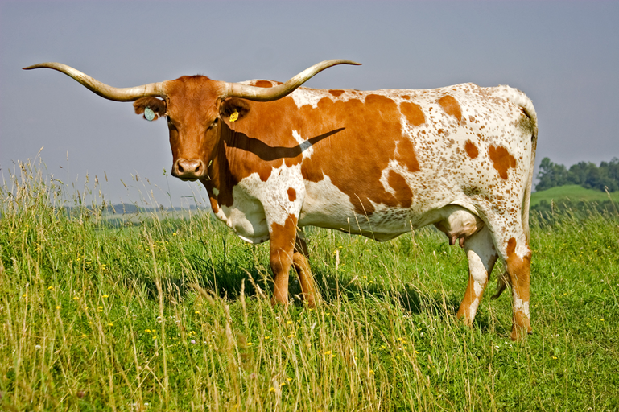
Key Occupations
Miner: Search for precious metals and valuable minerals out west.
Prospectors hope to get rich quick
Odds of success are not good
Cowboy: Raised Longhorn Cattle
Profit from a demand for beef in Northern cities
Located in southern Great Plains (Texas)
Cattle Drive – Annual Journey; carry cattle herds to railroad depot.
Long, dangerous trip: heat, Native Americans, rivers, storms

Slide 7
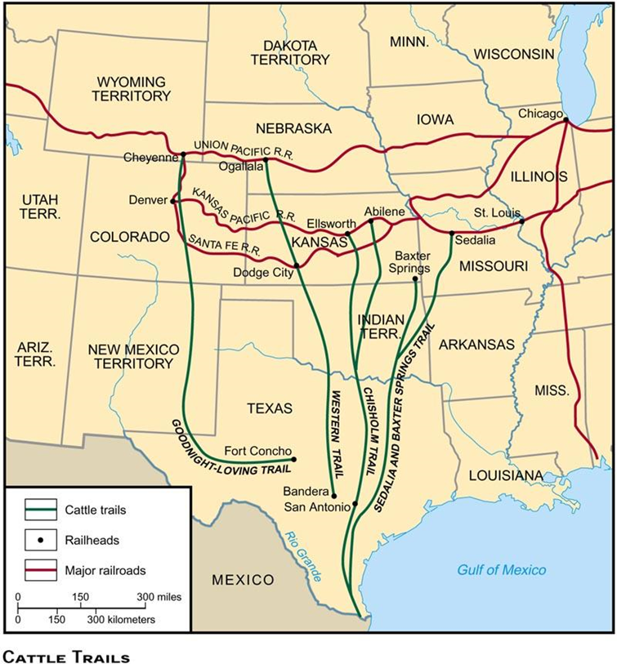
Key Trails – Help western towns grow
Chisolm Trail : Texas to Abilene, Kansas
Baxter Trail : Texas to Kansas City, MO
Goodnight – Loving Trail : Texas to Cheyenne, Wyoming

Slide 8
Homestead Act
Farmers lived on plots of land called homesteads
Homestead Act (1862) – Federal government plan to give 160 acres of free land to any settler who would move out west and improve the land for 5 years.
Exodusters – nickname for African Americans who moved out west to escape problems of South and receive free land.
Lived in Sod Homes; nicknamed a “soddy”
Faced hardships: droughts, Native American attacks, loneliness

Slide 9
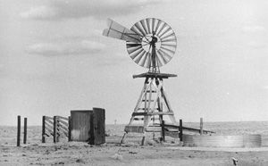
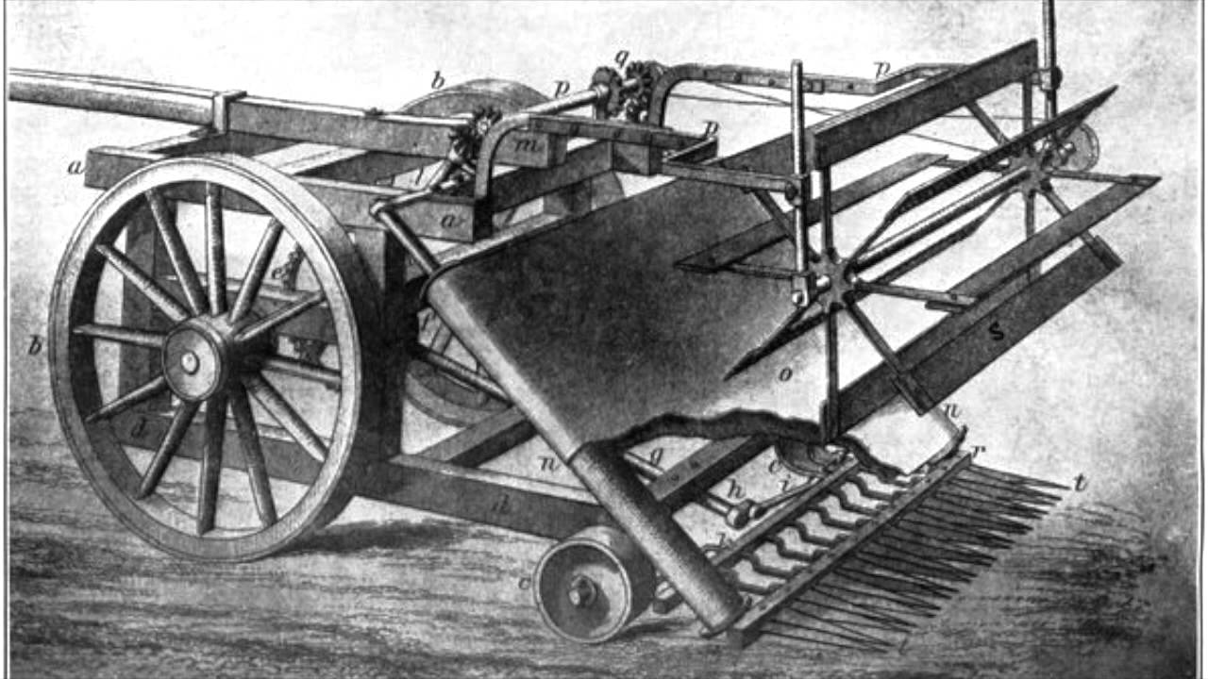
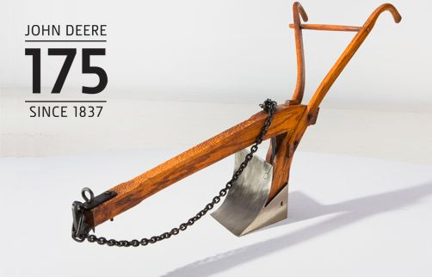
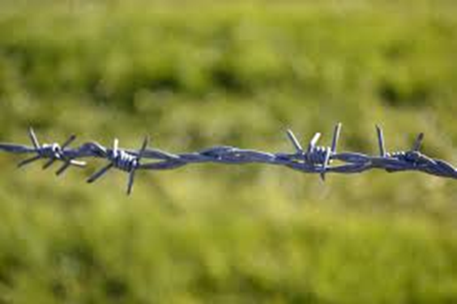
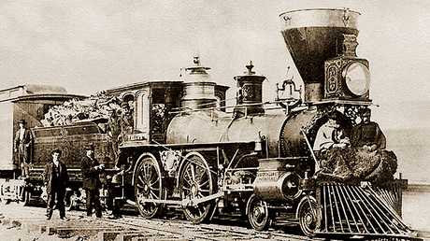
Technology
Technology was needed to make farming more productive in the Plains states.
Steel Plow – to break up the thick soil (sod)
Steel Windmill – needed to pump underground water
Mechanical Reaper – to harvest crops
Barbed Wire – to prevent animals from destroying crops
Transcontinental Railroad – to transport crops to market for selling

Slide 10
Problems faced on the great plains
Conflicts with Railroad Companies
Developed/ bought land, then sold land to settlers at higher prices
Charged premium rate for shipping
Corrupt Business of Railroads
Lack of Competition – few lines went through the Great Plains
Settlers faced high prices as a result
High Freight Rates – amounts charged for shipping goods
Charged more for short hauls – no competition
Conflicts with Native Americans
Indian Wars
Competition for resources like land, water, and buffalo cause fights
Last major battles between the Native Americans and American settlers

