Slide 1
Exploration and Colonization
American History I

Slide 2
What do you remember about exploration from WH?
We are going to focus on Spain, France and England.

Slide 3
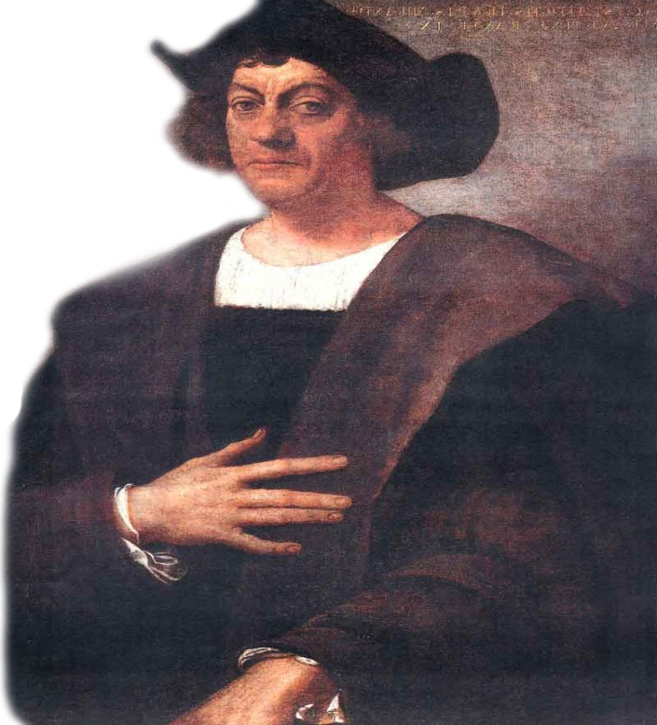
Motives for Exploration and Colonization
Spain
Gold, Glory, and God
Mostly men and missionaries who established religious outposts
Christopher Columbus looking for the East Indies by sailing across the Atlantic (1492)
“I have been very attentive and have tried very hard to find out if there is any gold here.”
“In every place I have entered, islands or land, I have always planted a cross.”
-Christopher Columbus

Slide 4
Motives for Exploration and Colonization
France
Economic gain
Fish, Forest, and Furs
Mostly men, no towns
or farms
England
Economic gain and colonization
Business of colonization – permanent settlements
Settlements – families who set up farms and towns

Slide 6
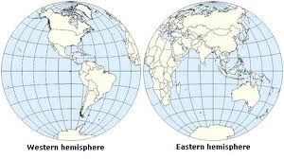
The Columbian Exchange
Exploration starts a global exchange and migration
-Began with the voyages of Columbus
-exchange between Western hemisphere ←→ Eastern hemisphere

Slide 7
The Columbian Exchange
Includes plants, animals, disease, technology
https://www.youtube.com/watch?v=r_hVqIeRpDU

Slide 9
Encomienda system
Spanish monarchs granted conquistadors encomiendas
The encomienda: was a legal system that was used to regulate (control) Native American labor.
In the encomienda system, the Spanish were to take responsibility for the Natives on their encomienda.

Slide 10
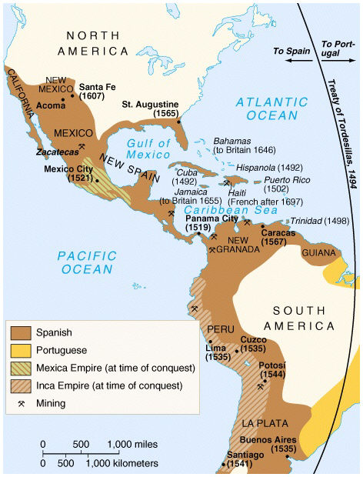
Encomienda System
Spanish holdings
in the Americas

Slide 11
Encomienda system
In theory, the receiver of the grant was to
protect the natives from warring tribes and
to instruct them in the Spanish language and in the Catholic faith.
In return they could extract tribute (payment) from the natives in the form of labor, gold, or other products.
In practice, the difference between encomienda and slavery could be minimal. Many natives were forced to do hard labor and subjected to extreme punishment and death if they resisted.

Slide 12
As the native population was decimated by disease the Spanish began to look for a different labor source.
Slaves replaced the native population as labor on encomiendas.

Slide 13
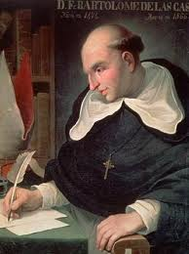
Encomienda system
Bartolome de Las Casas (priest)
spoke out against the
encomienda system
-the system was outlawed
and replaced with slavery

Slide 14
The trade of slaves and goods across the Atlantic was called the Triangular Trade Network.

Slide 15
Triangular Trade Across the Atlantic

Slide 16
Triangular Trade Across the Atlantic
Which part of the triangle is referred to as the “Middle Passage”?

Slide 17
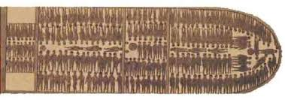
Horrors of the Middle Passage
Africans were kidnapped from their villages -tied together and forced to walk to port cities
Once on the ships they were restrained below deck -disease, starvation, and suicide common -slave ships were often called floating coffins
Notes:
Show video from Discovery Education

Slide 18
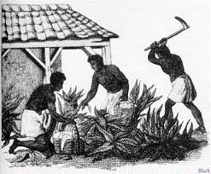
Impact of the Atlantic Slave Trade
Slave trade brought wealth and labor to the Americas
African states were torn apart and lives were cut short or forever brutalized
At the peak of the slave trade (1780s) 80,000 slaves were traded a year!

Slide 19
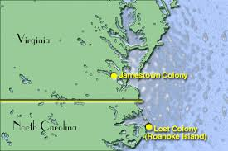
The First English Colonies
England’s first attempt to create a settlement in North America was on Roanoke Island in North Carolina.

Slide 20
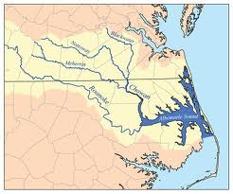
This settlement failed and is today called the Lost Colony.
lost colony

Slide 22
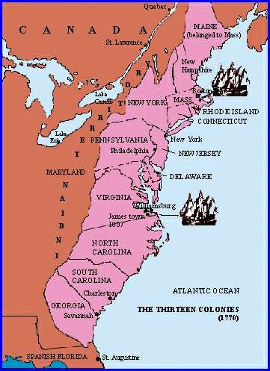
The FirstEnglish Colonies
The first permanent English settlement was in Jamestown, Virginia in 1607
Complete Jamestown w/s here
http://www.history.com/topics/jamestown/videos/death-at-jamestown#death-at-jamestown

Slide 23
Pocahontas
video clip

Slide 24
Jamestown
Do 2nd page of w/s

Slide 25
Indian Relations and Conflicts
Virginia
The English desire for more land led to war with Native Americans
The poor relations eventually led to Bacon’s Rebellion
Read p. 48 and 49 (blue book) and answer the questions about Bacon’s Rebellion

Slide 26
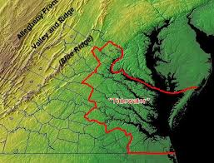
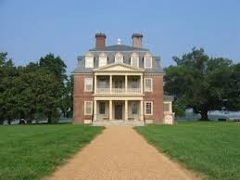
Bacon’s Rebellion Background
Wealthy Planters lived on Virginia’s eastern shores (the tidewater) where they owned most of the land and farmed on large plantations

Slide 27
Bacon’s Rebellion Background
These wealthy planters controlled Virginia’s legislature (lawmaking group) and elected most of its members
Because so many representatives were from the tidewater the taxes in the tidewater were very low

Slide 28
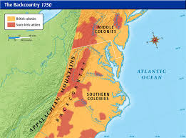
Bacon’s Rebellion Background
Former indentured servants of the tidewater plantations lived in the Virginia Backcountry

Slide 29
These poor farmers could not vote and paid high taxes that were used to pay for services for tidewater planters
Also living in the backcountry were a number of Native American tribes
Nathaniel Bacon asked Governor William Berkley to send troops to the backcountry to help protect the backcountry farmers

Slide 30
Berkley refused
Bacon gathered more than 1000 farmers and marched to Jamestown.
Berkeley fled and Bacon burns Jamestown
Unfortunately Bacon dies a month later and Berkley returns to put down the rebellion

Slide 31
Bacon’s Rebellion is where we see colonists first express the idea of “no taxation without representation”
Where else will we see this idea expressed?

Slide 32
The First English Colonies
The second British colony in North America was in Plymouth
Massachusetts

Slide 33
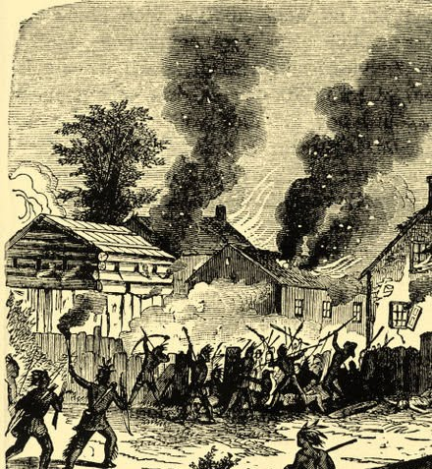
Indian Relations and Conflicts
King Philip’s War
Metacom (King Philip) led attacks against colonists in New England.
War waged for over a year and 1/10 of colonial men of military age died.
Native Americans suffered heavy causalities, food shortages, and disease.
Native Americans eventually surrendered.
Native American power in New England gone

Slide 34
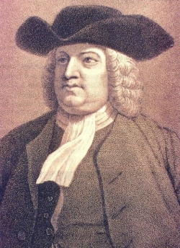
Indian Relations and Conflicts
The Quakers
Religious group led by William Penn settle in Pennsylvania.
Quakers were pacifists and practiced freedom of religion.
Believed the land belonged to the Natives
Wanted Natives to be treated fairly (court)
For 50 years, PA had no major conflicts with Natives

Slide 35
French
First permanent English settlement was in Jamestown, VA in 1607 -colony made money by cultivating tobacco
Pilgrims landed in Plymouth, MA in 1620 -escaped persecution of church -signed Mayflower Compact (direct democracy)
Puritans settled Massachusetts Bay
-“City upon a hill” ideal
-Church and state overlap
-Dissenters: Roger Williams and Anne Hutchinson

