Slide 1
Division in Congress
The Wilmot Proviso divided Congress along regional lines. Northerners, angry over the refusal of Southern congressmen to vote for internal improvements, such as the building of canals and roads, supported the proviso.
Southerners, as expected, opposed the proviso, which, some argued raised complex constitutional issues.
Slaves were property, claimed Southerners, and property was protected by the Constitution.

Slide 2
Decision Factors
Many Southerners feared that if the Wilmot Proviso became law, the inevitable addition of new free states to the Union would shift the balance of power permanently to the North.
The House of Representatives approved the proviso, but the Senate rejected it.

Slide 3
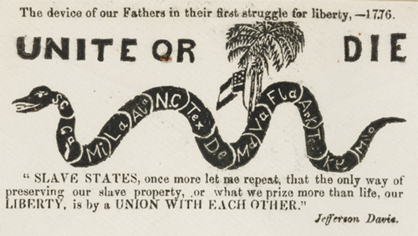
Secession
Debates over slavery in the District of Columbia and failure to enforce the Fugitive Slave Act of 1793 divide Congress even more.
Southerners threaten secession—the formal withdrawal of a state from the Union.

Slide 4
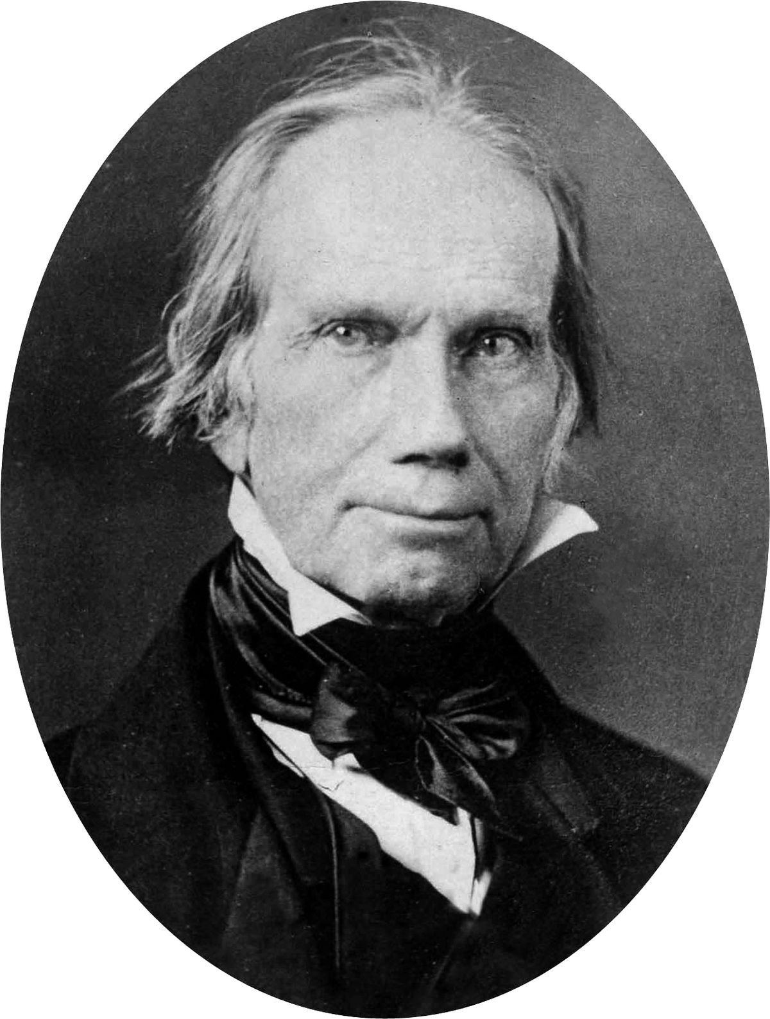
Clay’s Compromise – of 1850
To please the North, California would be admitted to the Union as a free state.
To please the South, the compromise proposed a new and more effective fugitive slave law.
Finally, the idea of popular sovereignty was proposed in this compromised.

Slide 5
Compromise Cont’d -- Popular Sovereignty
Another part of Clay’s compromise that pleased both the North and the South was called Popular Sovereignty.
This allowed residents of the territories of New Mexico and Utah the right to vote for or against slavery in their area.

Slide 6
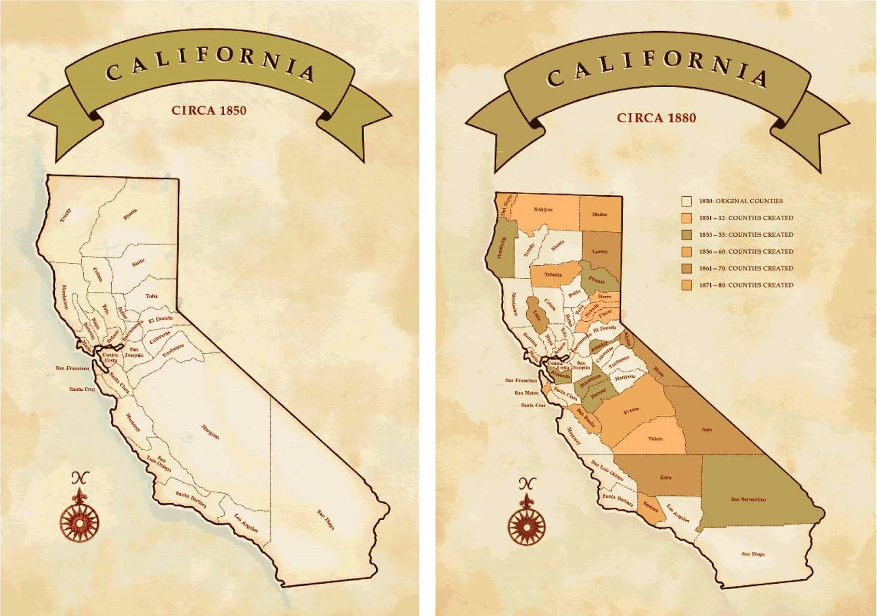
Statehood for California
As a result of the gold rush, California had grown in population so quickly that it skipped the territorial phase of becoming a state.
In late 1849, California held a constitutional convention and adopted a constitution that forbade slavery—a fact that alarmed many Southerners.
President Zachary Taylor supports the idea of popular sovereignty.

Slide 7
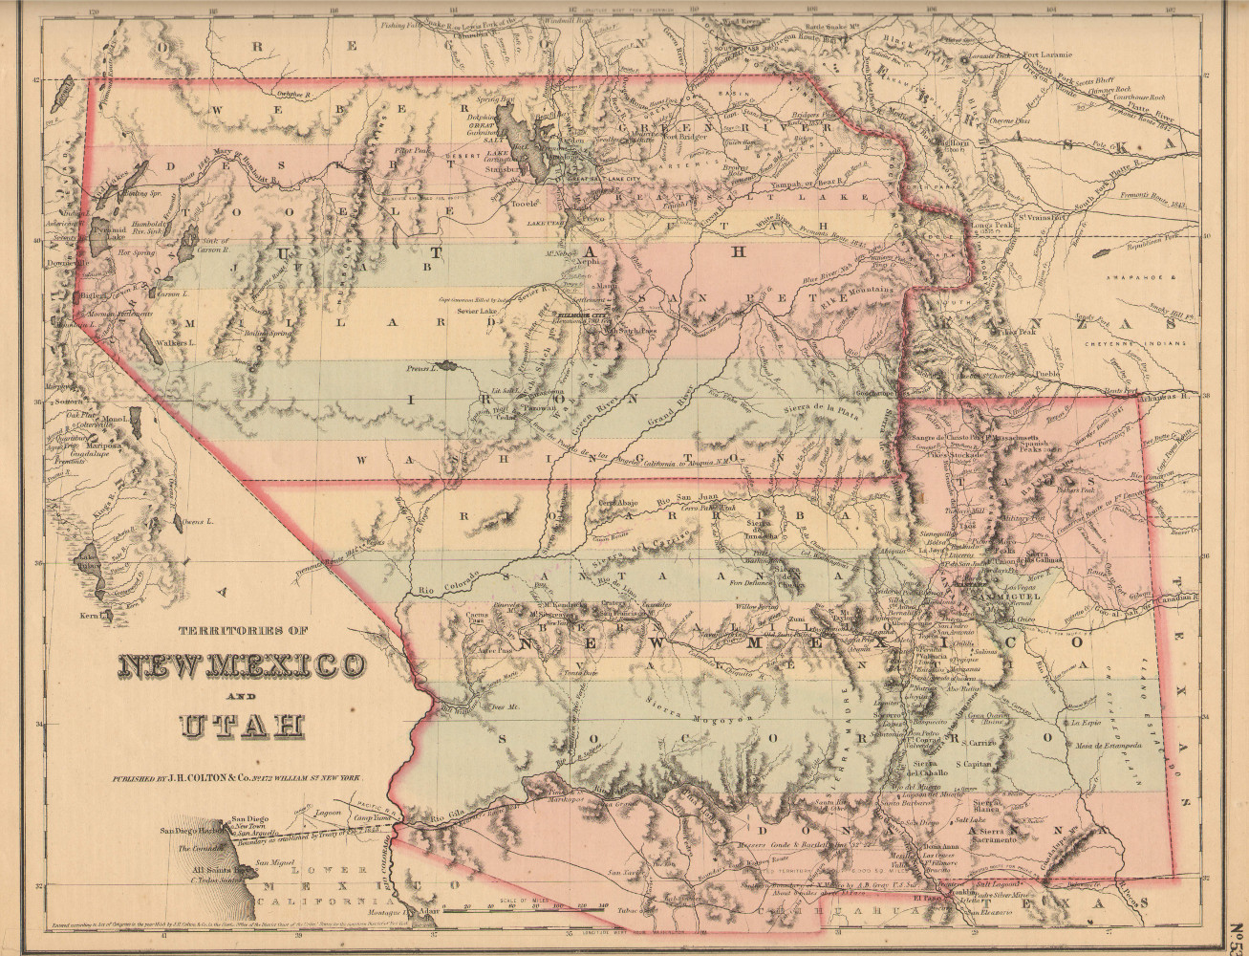
Buying New Mexico
The final part of the Compromise of 1850 was that the federal government would buy New Mexico from Texas for $10M.
Northerners were pleased because it limited slavery in Texas to within its borders.
Southerners were pleased because the money would help defray Texas’s expenses and debts from the war with Mexico.

Slide 8
Path to Compromise
Henry Clay proposes “Compromise of 1850”
Initial Plan rejected—Clay, discouraged, leaves Washington DC
Stephen Douglass takes up the fight and introduces each piece of the bill one at a time
President Taylor dies and is replaced by Millard Fillmore who supports compromise
Calhoun dies and southern leaders support the compromise
Compromise is voted into law in September 1850

Slide 9
North | Provision | South
Against slavery | CA admitted as free
 | Stricter enforcement of Fugitive Slave Law
 | Utah and New Mexico decide for themselves slave or free
 | TX paid $10 million to settle land dispute with New Mexico
 | Slave trade banned in DC – slavery not

Slide 10
North | Provision | South
Against slavery | CA admitted as free
 | Stricter enforcement of Fugitive Slave Law | Runaway slaves (property) would be returned if they escaped bondage
 | Utah and New Mexico decide for themselves slave or free
 | TX paid $10 million to settle land dispute with New Mexico
 | Slave trade banned in DC – slavery not

Slide 11
North | Provision | South
Against slavery | CA admitted as free
 | Stricter enforcement of Fugitive Slave Law | Runaway slaves (property) would be returned if they escaped bondage
Confined slavery to current Texas state boundaries and allowed other states the choice | Utah and New Mexico decide for themselves slave or free
 | TX paid $10 million to settle land dispute with New Mexico
 | Slave trade banned in DC – slavery not

Slide 12
North | Provision | South
Against slavery | CA admitted as free
 | Stricter enforcement of Fugitive Slave Law | Runaway slaves (property) would be returned if they escaped bondage
Confined slavery to current Texas state boundaries and allowed other states the choice | Utah and New Mexico decide for themselves slave or free
 | TX paid $10 million to settle land dispute with New Mexico | Southerners were pleased because the money would help defray Texas’s expenses and debts from the war with Mexico
 | Slave trade banned in DC – slavery not

Slide 13
North | Provision | South
Against slavery | CA admitted as free
 | Stricter enforcement of Fugitive Slave Law | Runaway slaves (property) would be returned if they escaped bondage
Confined slavery to current Texas state boundaries and allowed other states the choice | Utah and New Mexico decide for themselves slave or free
 | TX paid $10 million to settle land dispute with New Mexico | Southerners were pleased because the money would help defray Texas’s expenses and debts from the war with Mexico
Extension of slavery is prohibited | Slave trade banned in DC – slavery not | Current institution still exists

