Slide 1
Changes in the West: Native Americans

Slide 2
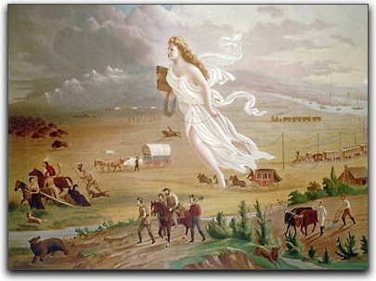
Manifest Destiny
“An expression of the legacy of the unique mission of Americans, but also a belief in America as the vessel of the progress of civilization.” - John L O’Sullivan

Slide 3
Manifest Destiny:
The 19th century view that America was destined to expand across the North American continent

Slide 4
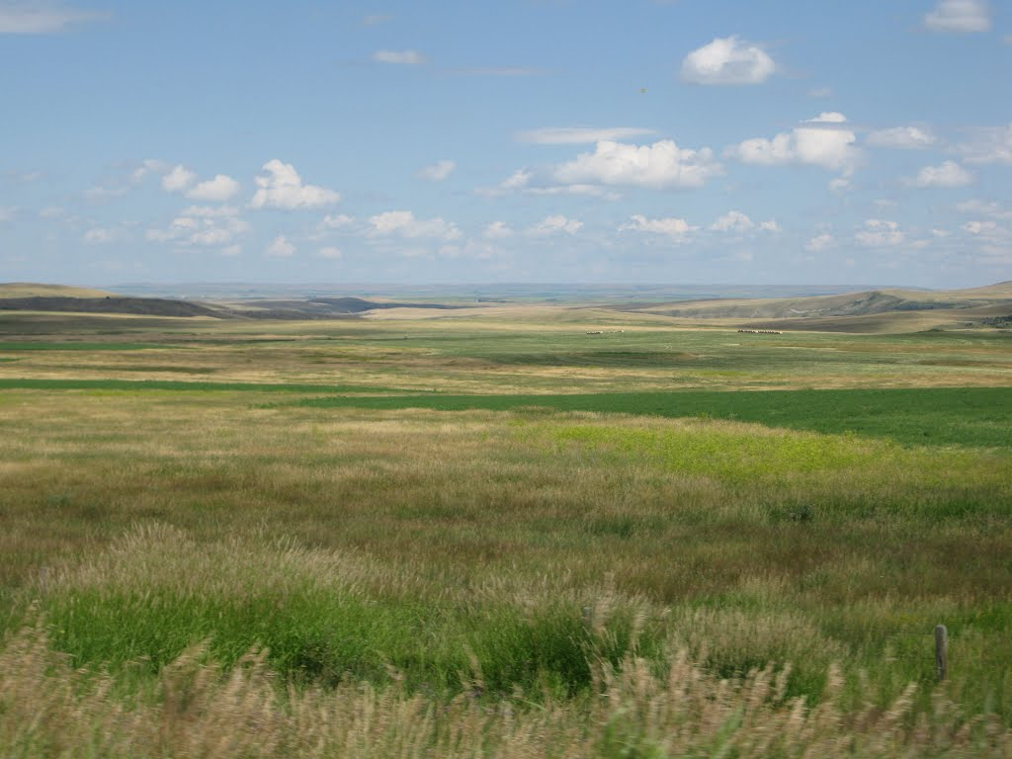
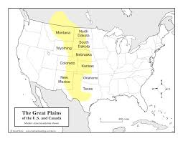
Plains Indians
Great Plains

Slide 5
Plains Indians
Role of…Family, Horses and Buffalo
Family:
Lived in small, extended family groups
Believed powerful spirits controlled the events in the natural world
Tribes were ruled by counsels
Land was held in common use for the entire tribe

Slide 6
Horses:
Increased mobility
Travel greater distances
Hunt more efficiently
Buffalo:
Every part was used
Tepees, clothing, food, bowstrings, decorations, tools, toys…

Slide 7
Why did white people come to the Great Plains?
Gold
Land
Fresh Start

Slide 8
GOLD!
1849 – California Gold Rush still going strong
1858 – gold discovered in Colorado
1868 – gold discovered in Black Hills of South Dakota
* Thousands came to these areas hoping to strike it rich, and wanted to settle on Native American Land

Slide 9
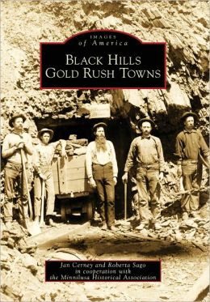
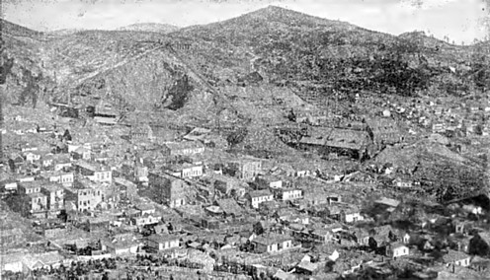
Lead, South Dakota
Gold rush towns were often rows of tents and shacks with dirt (mud) streets

Slide 10
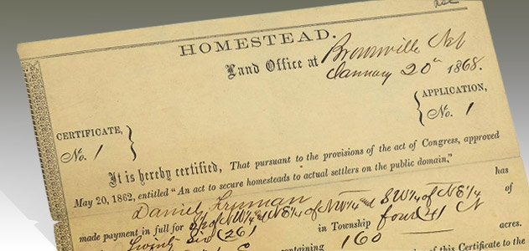
Land!
1862 Congress passes the HOMESTEAD ACT
160 acres of free land to anyone who will farm it for 5 years
400,000 to 600,000 families took this offer

Slide 11
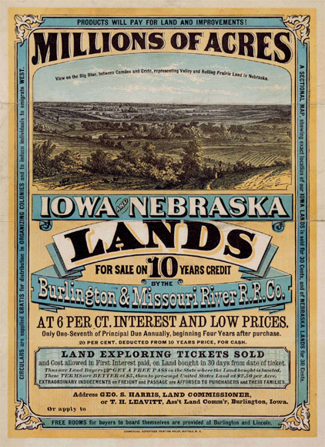
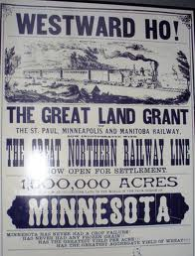
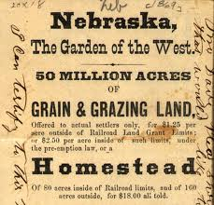

Slide 12
The Homestead Act
https://www.youtube.com/watch?v=5KxooR9my1Q

Slide 13
Santana, Chief of the Kiowas, 1867
“A long time ago this land belonged to our fathers; but when I go up to the river I see camps of soldiers here on its bank. These soldiers cut down my timber; they kill my buffalo; and when I see that, my heart feels like bursting; I feel sorry.”

Slide 14
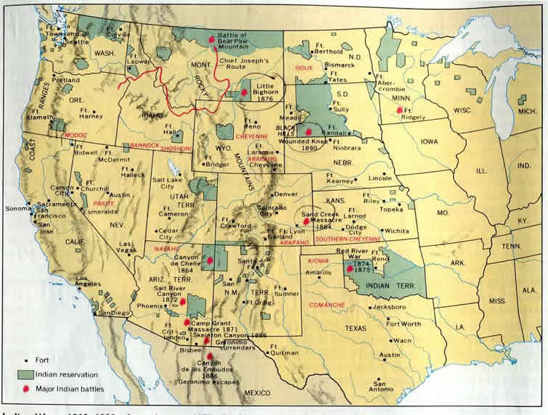
US Government Policy Toward Native Americans
1834 – Entire Great Plains set aside for Native Americans
1850’s government reverses policy and begins to restrict Native Americans to reservations

Slide 15
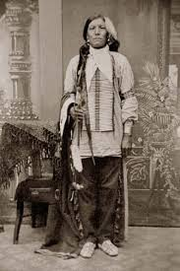
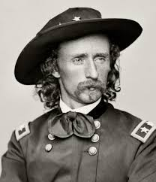
Native Americans
Sand Creek (1864) – p. 383
June 1876 – Custer’s Last Stand
George Custer defeated by Cheyenne
(Crazy Horse) in Montana

Slide 16
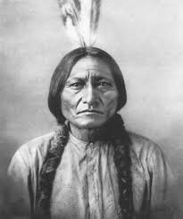
Nation outraged
Army continues campaign
Sitting Bull surrenders 1881

Slide 17
End of the Indian Wars
1890
A Sioux prophet told that if the Sioux did a dance called the GHOST DANCE their lands would be returned
The Ghost Dance spread quickly
The military became alarmed and went to arrest Sitting Bull

Slide 18
Sitting Bull’s body guard fired at the police
The police fired back – killing Sitting Bull
December 1890 – 350 Sioux taken to Wounded Knee, South Dakota
One Native American resisted turning over weapons and fired his rifle…

Slide 19
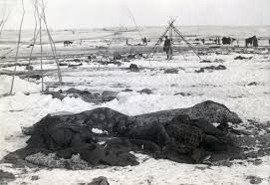
Soldiers open fire
300 unarmed Sioux killed and left to freeze on the ground
This “battle” the Battle of Wounded Knee ended the Indian Wars

Slide 20
Massacre at Wounded Knee
https://www.youtube.com/watch?v=PkJaYe1T8l8

Slide 21
ASSIMILATION – Dawes Act - 1887
Designed to encourage the breakup of tribes and promote the assimilation of Indians into American Society.
Goal – create independent farmers out of Indians
Land:
Broke up reservations and distributed the land (160 acres per family)

Slide 22
Results
Best land sold
No money returned to Native Americans
- The land that was meant to be Indian land was soon controlled by non-Indians

Slide 23
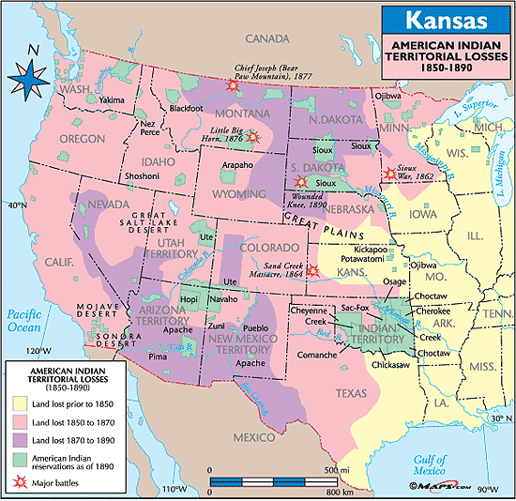

Slide 24
http://invasionofamerica.ehistory.org/
http://www.slate.com/blogs/the_vault/2014/06/17/interactive_map_loss_of_indian_land.html

Slide 25
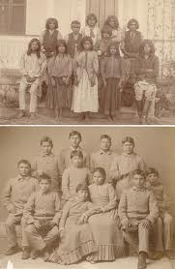
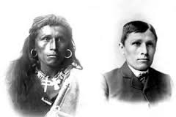
Education:
- Taught Native American children their traditional ways were backward
- Promoted values of “white civilization”

Slide 26
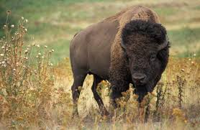
Buffalo:
traders, sport hunters and fur traders all killed the buffalo
1800 – 15 million buffalo
1886 – 600
Today – 4000
Put an end to
the plains way
of life

Slide 27
The Dawes Act, re-Education, and the end of the buffalo…
John Green
Until 8:00

