Slide 1
Industrial Revolution
Unit 6
Westward Expansion

Slide 2
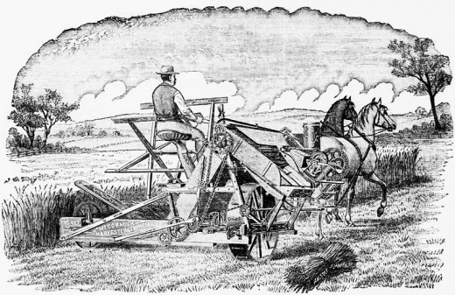
Specialization
Farmers began to shift from focusing on subsistence farming to specialization -- raising 1 or 2 cash crops that could sell at home or abroad.

Slide 3
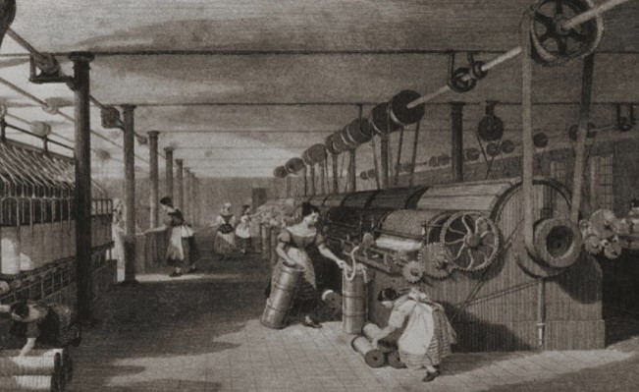
Market Revolution
People bought and sold goods rather than simply using goods they personally produced in their home.

Slide 4
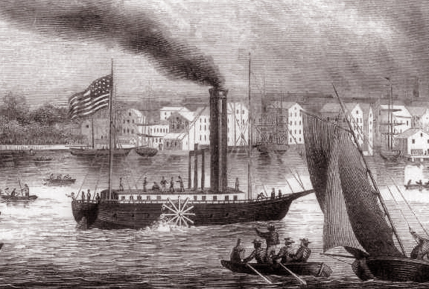
Capitalism
Private businesses or individuals control the means of production

Slide 5
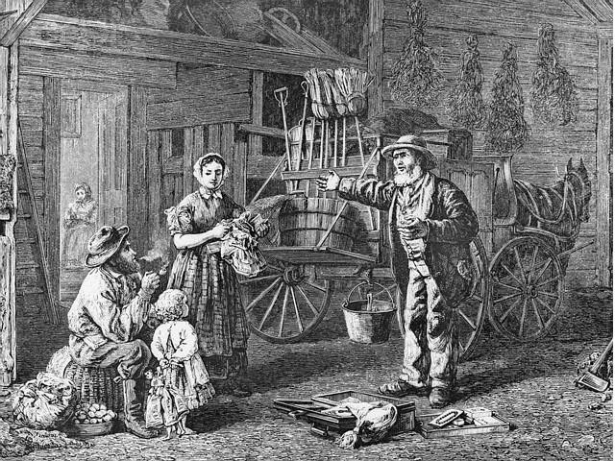
Entrepreneurs
People who risk their own money in new industries.

Slide 6
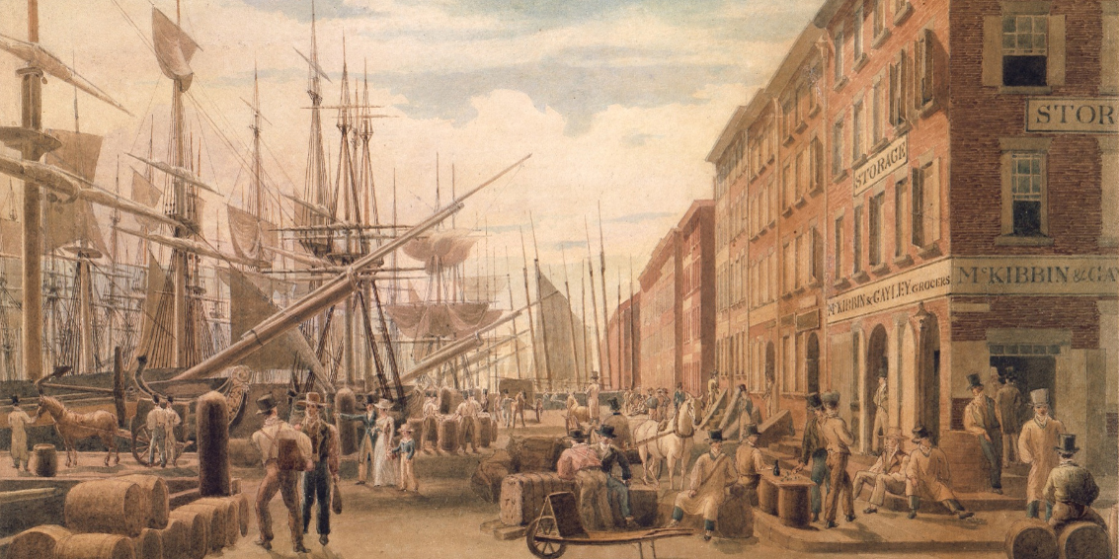
Impact on Household economy
Farmers produced – cotton, grain, livestock
and
Purchased – textiles and machinery
How did the cities and farms help each other?
- Farms provided necessary food and raw materials (cotton) to the cities.
- Cities provided manufactured equipment and goods.

Slide 7
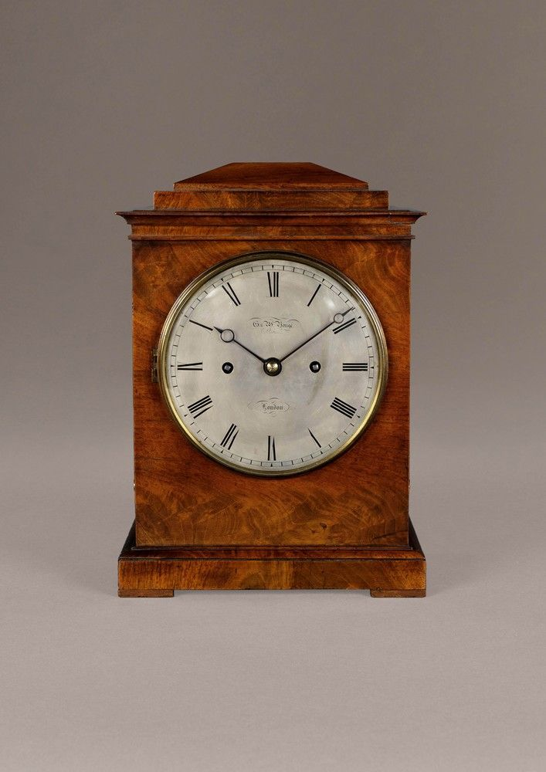
Benefits of Market Revolution
Decrease in price to produce:
- Handmade clock before market revolution would cost $50.00
- Machine made clock made after market revolution would cost $0.50
Thus a manufacturer could reduce the asking price and sell his or her product for much cheaper while still making as much or more money.

Slide 8
Talk with a partner…
What did cheaper machine made items allow Americans to do?
How did cheaper items change American lives?

Slide 9
Talk with a partner…
What did cheaper machine made items allow Americans to do?
Allowed Americans to buy goods rather than having to produce everything they needed at home.
How did cheaper items change American lives?
The Market Revolution lead to an increase in production of goods and services while the average American income rose significantly.
In fact, in the 1840s alone, the national economy grew more than it had in the previous 40 years.

Slide 10
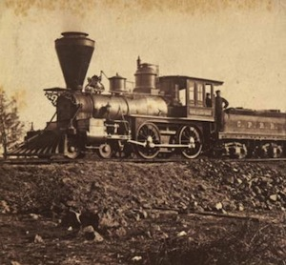
Northeast
- Heavy investments in canals and railroads transformed the Northeast into the center of American commerce.
- Manufacturing and shipbuilding were industries that took hold and thrived in the Northeast.
Although most Americans still lived in rural areas and only 14% of workers had manufacturing jobs, these workers produced more and better goods at lower prices than had ever been produced before.

Slide 11
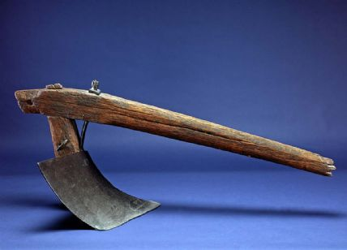
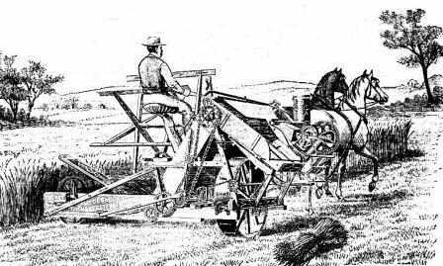
Midwest
As the Northeast began to industrialize, many people moved to farm the fertile soil of the Midwest. While fertile, this land required much work to make the land arable or fit to cultivate.
To solve this problem:
In 1837, John Deere created the steel plow.
Then Cyprus McCormick invented the mechanical reaper—which allowed one farmer to do the work of five hired hands.

Slide 12
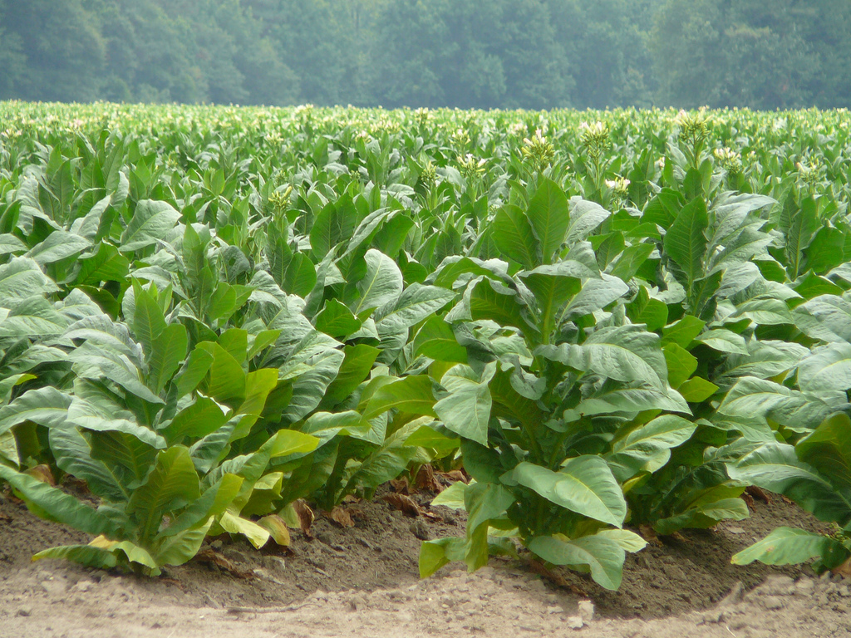
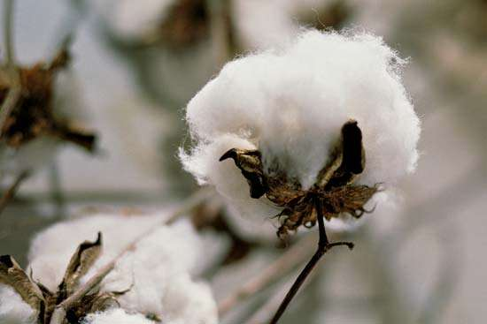
South
Most of the South remained agricultural and relied on crops such as cotton, tobacco, and rice.
Many southerners resisted industrialization—especially ones who had visited northern cities and deemed them “filthy and overcrowded”.
Additionally, most southerners (even the wealthy) lacked capital to build factories…most of their money was tied up in land.

